Slide 1
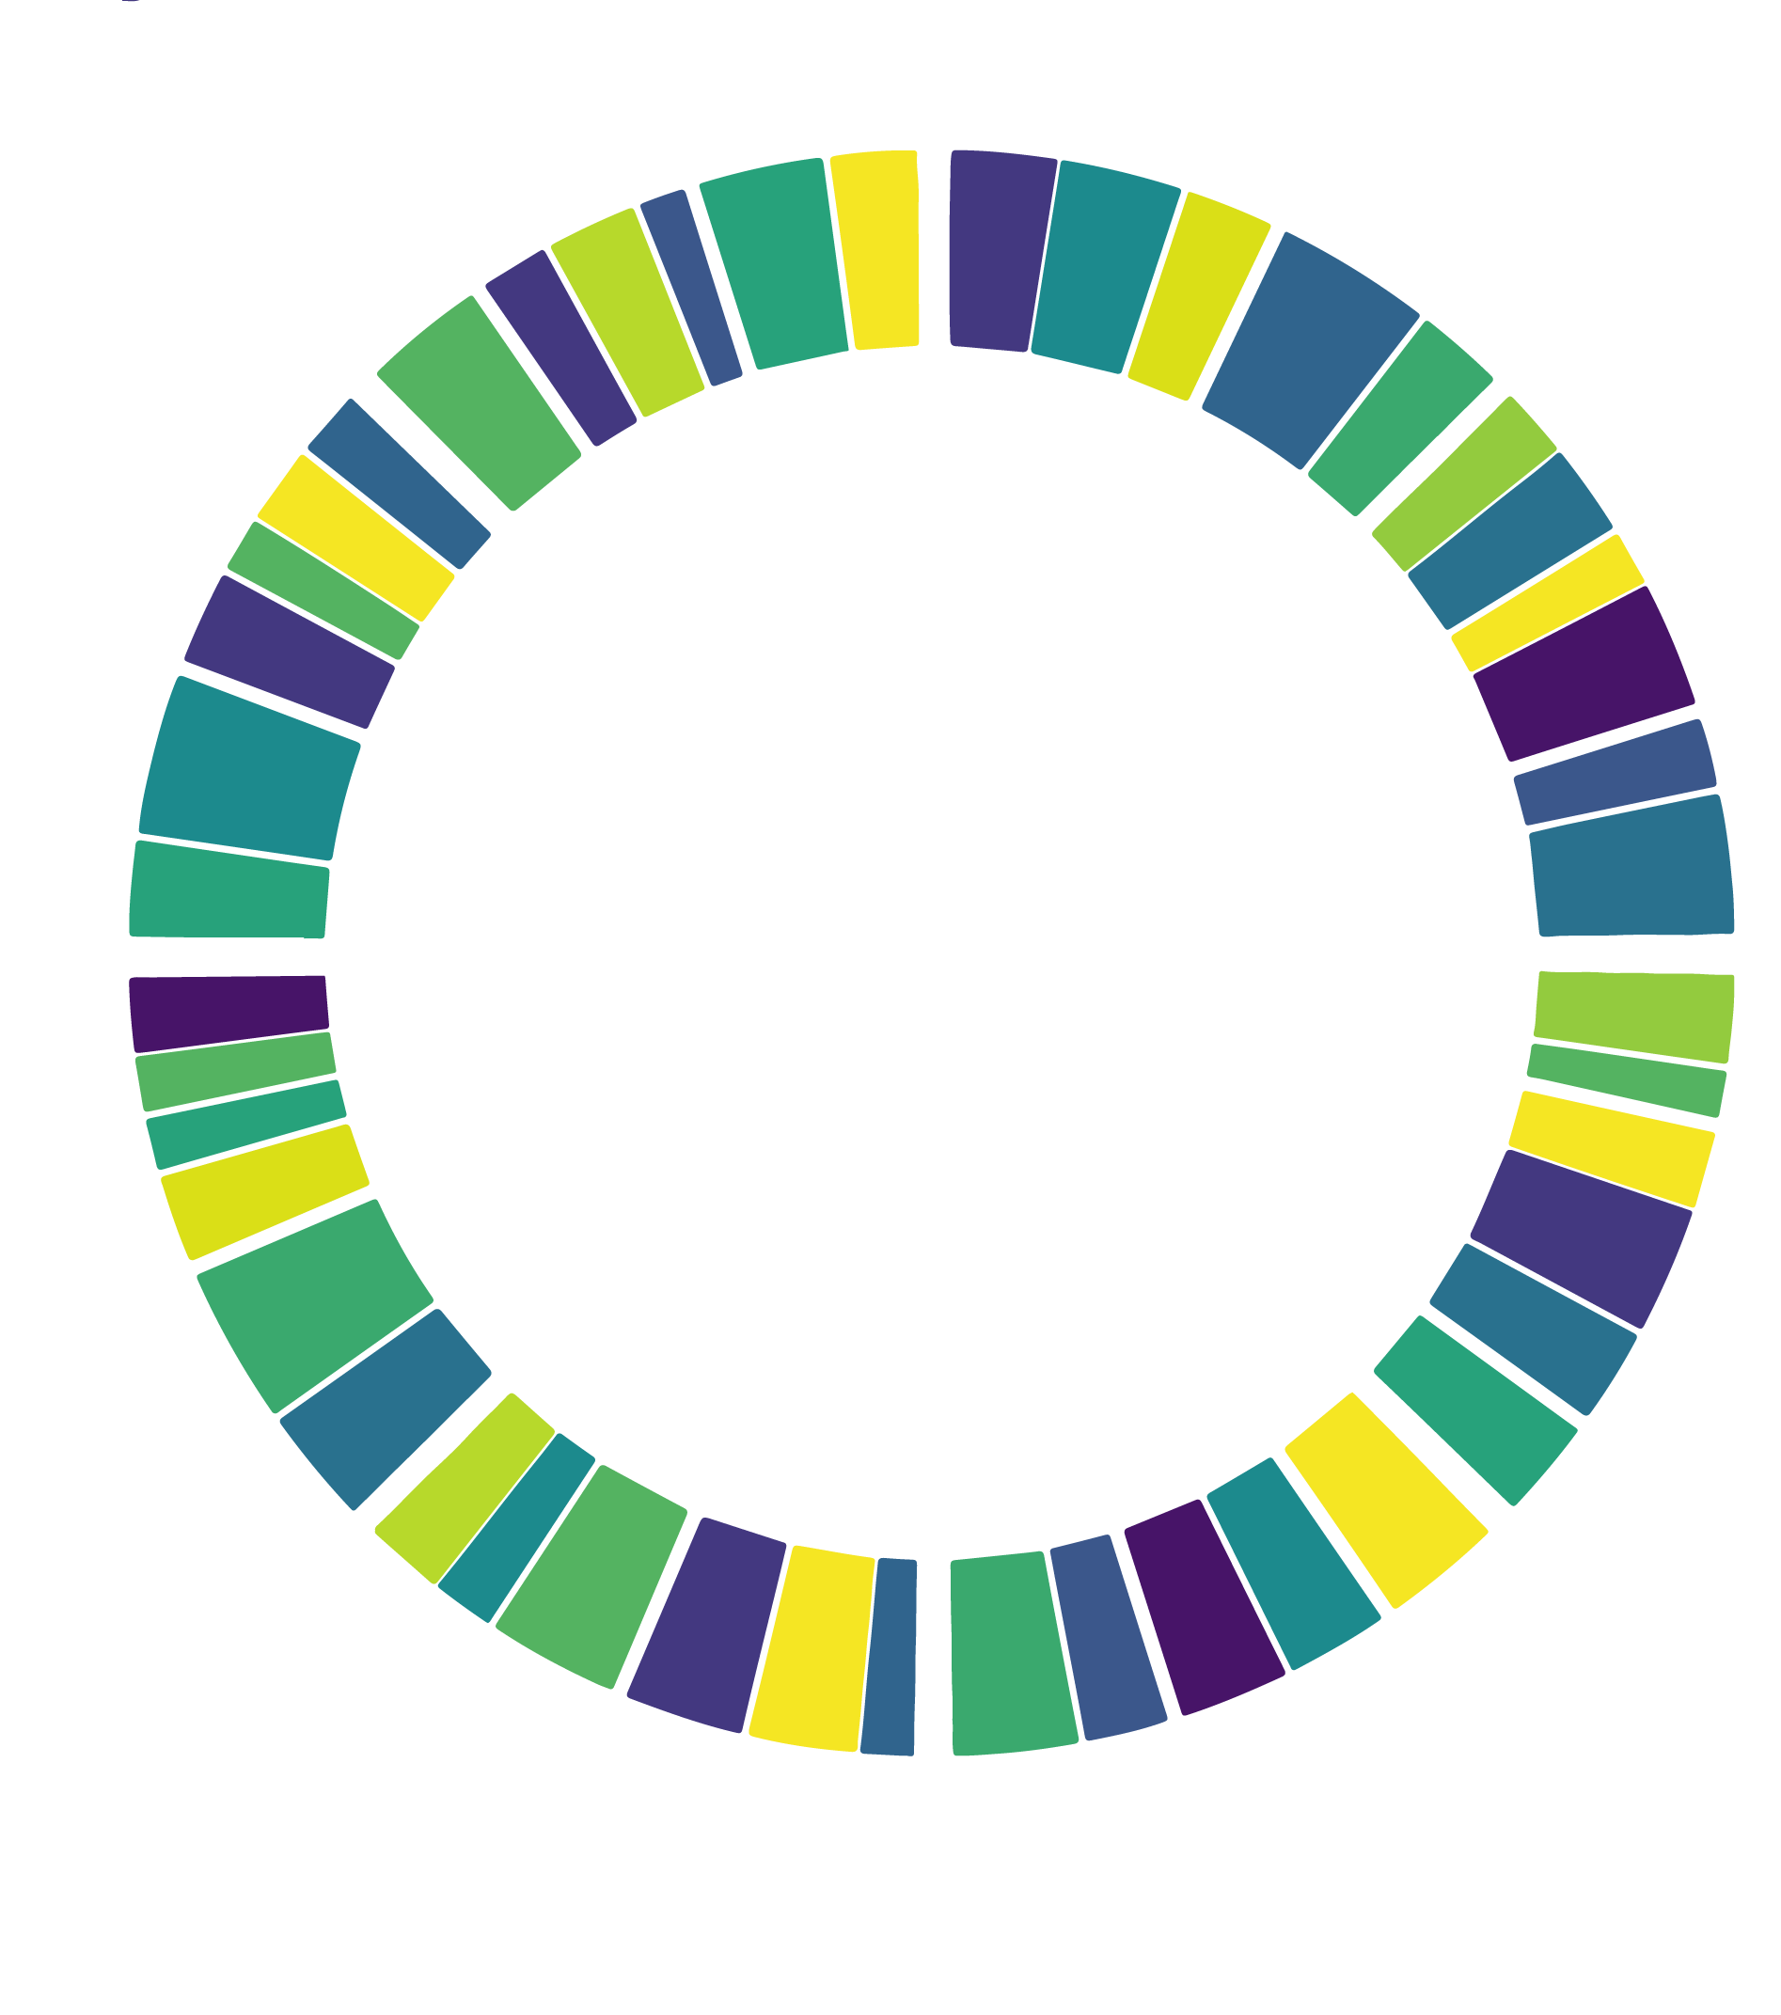
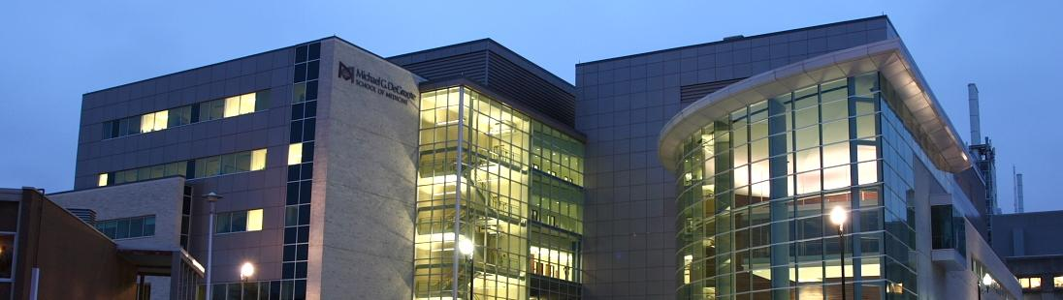
Pandemics Fast & Slow: COVID-19 and AMR
Andrew G. McArthur, Ph.D.
Michael G. DeGroote Institute for Infectious Disease Research
Department of Biochemistry & Biomedical Sciences
McMaster University
mcarthurbioinformatics.ca I card.mcmaster.ca I iidr.mcmaster.ca

Slide 2
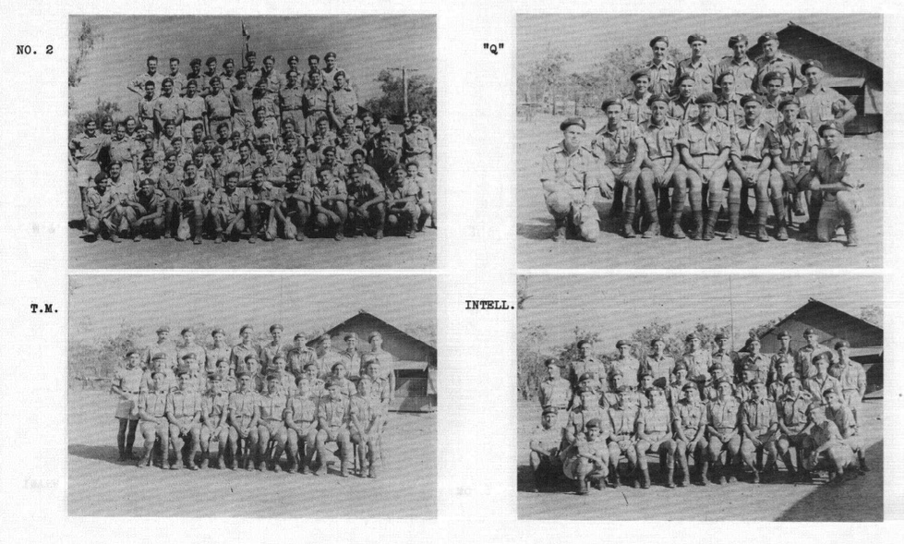

1st Canadian Special Wireless Group, Royal Canadian Corps of Signals - 1944
DETECT
DECODE
DEPLOY

Slide 3


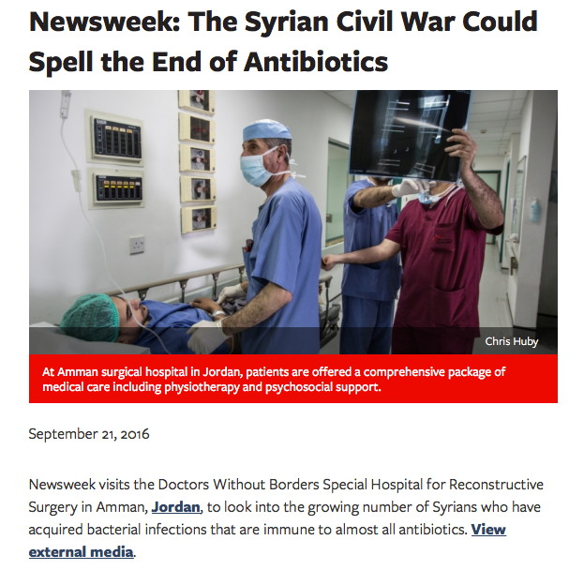


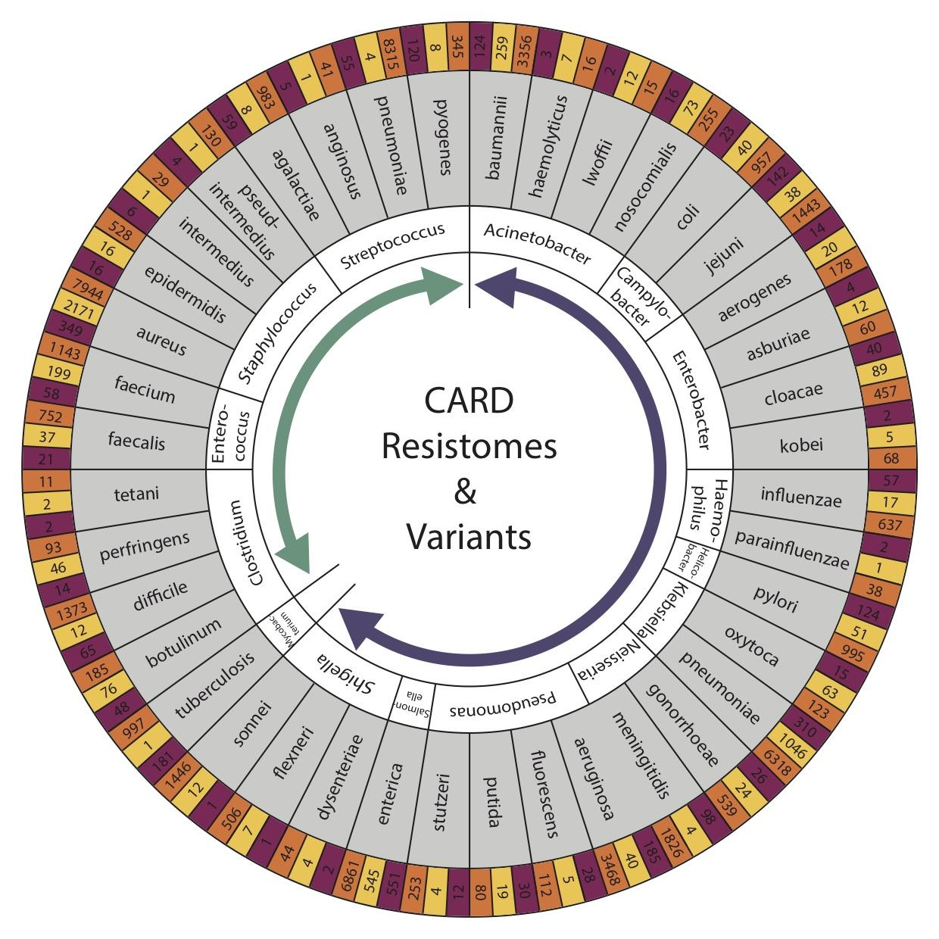


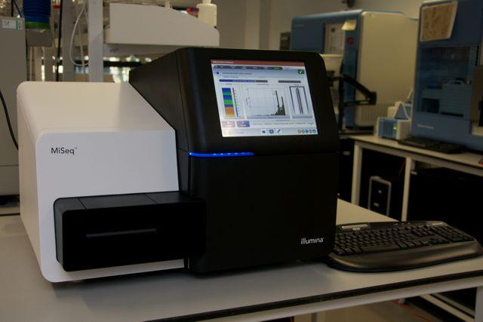
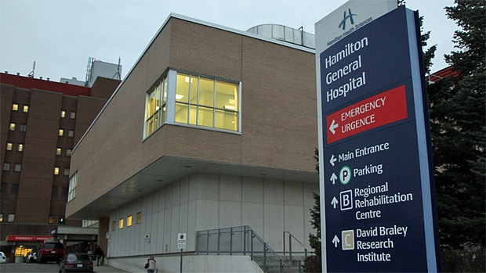

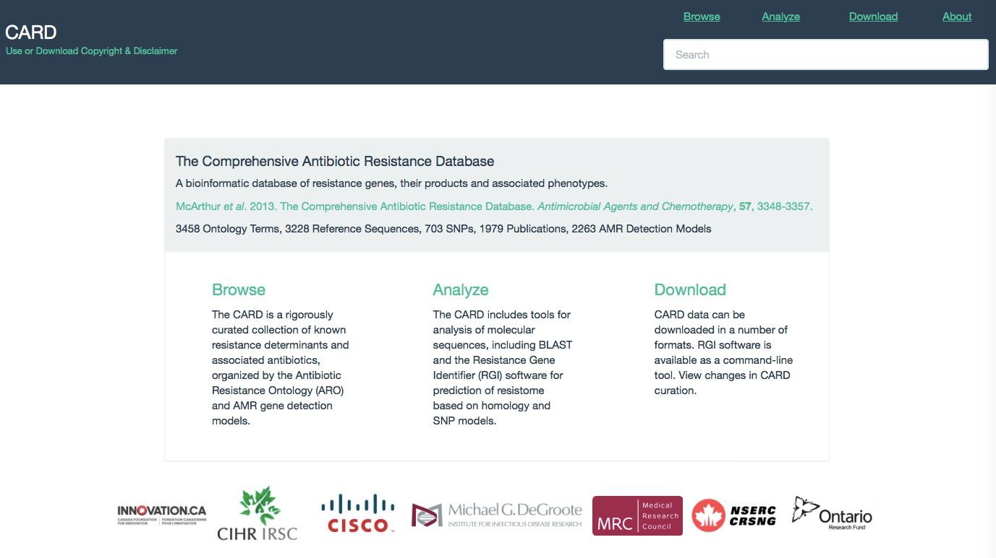
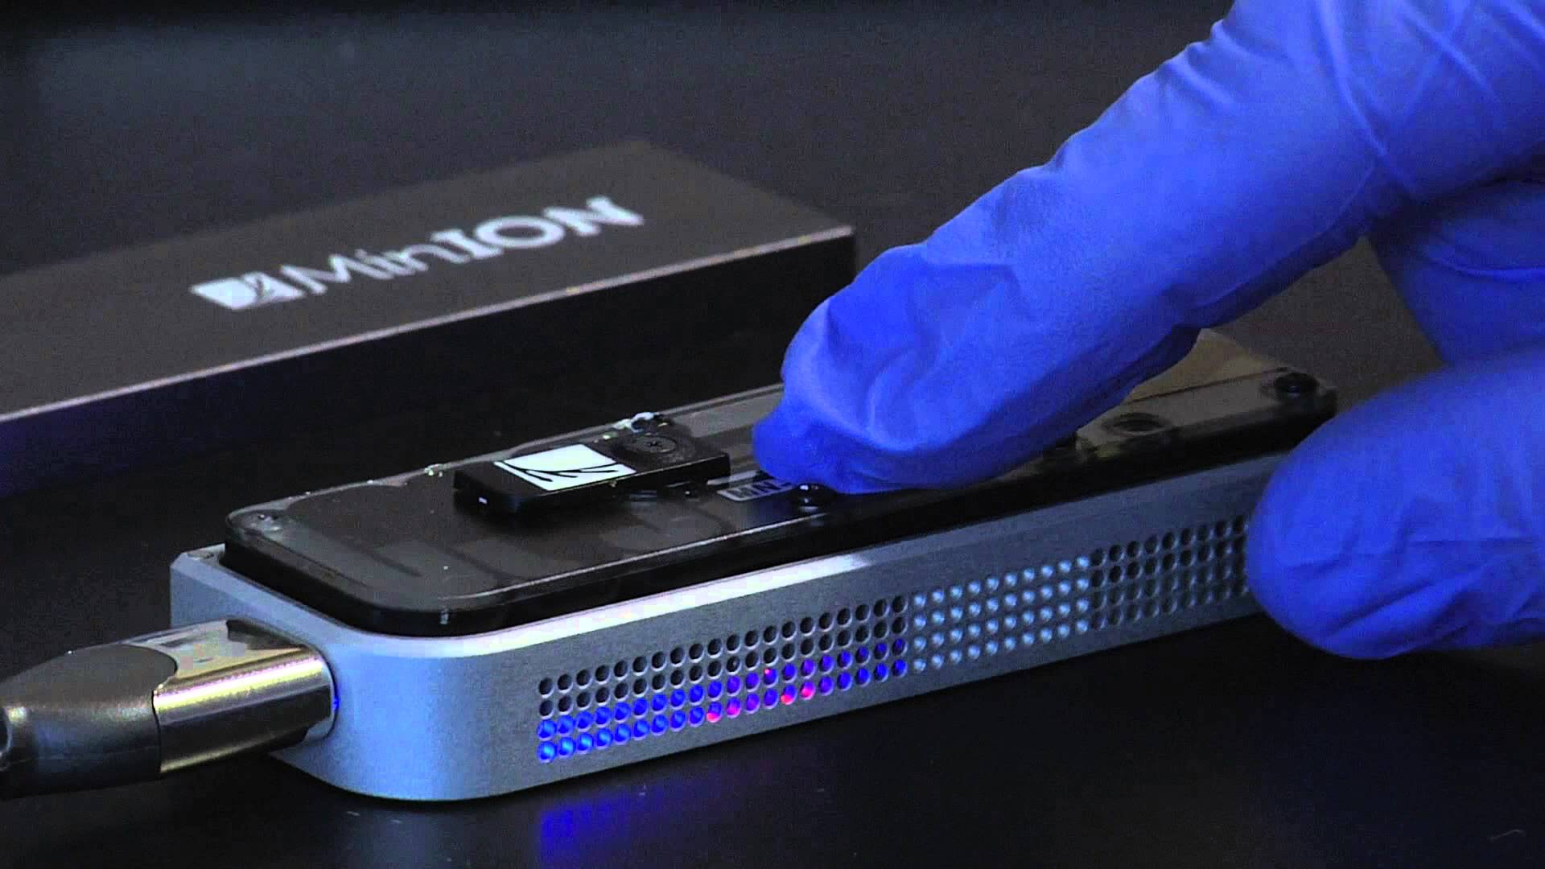
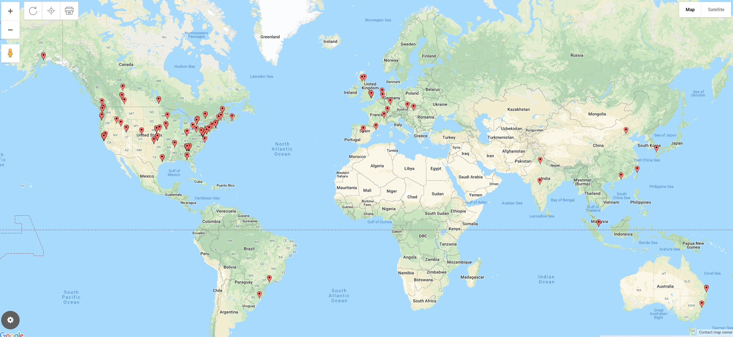
Antimicrobial Resistance
Analytics
Bioinformatics
DNA Sequencing
Biocuration
Public Health Agency Usage 2019
DETECT
DECODE
DEPLOY
patient
community
national & international
diagnostics
outbreaks
surveillance

Slide 4
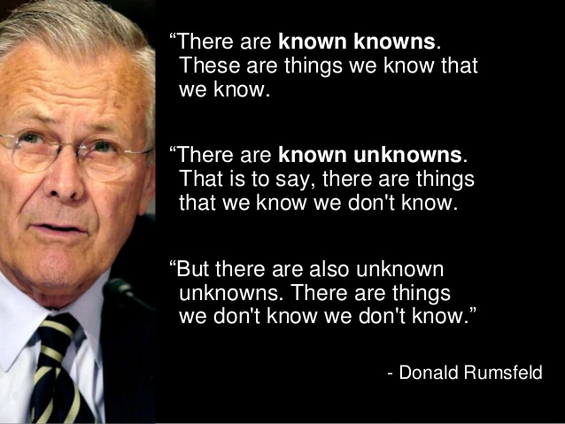
Donald Rumsfeld (US Secretary of Defense 1975-1977, 2001-2006)

Slide 5


Slide 6
Genes & Pathogens we are tracking
Characterized genes & pathogens we don’t routinely track; variants of known genes; novel mutations
Emergent threats

Slide 7
genome sequencing!
Genes & Pathogens we are tracking
Characterized genes & pathogens we don’t routinely track; variants of known genes; novel mutations
Emergent threats

Slide 8
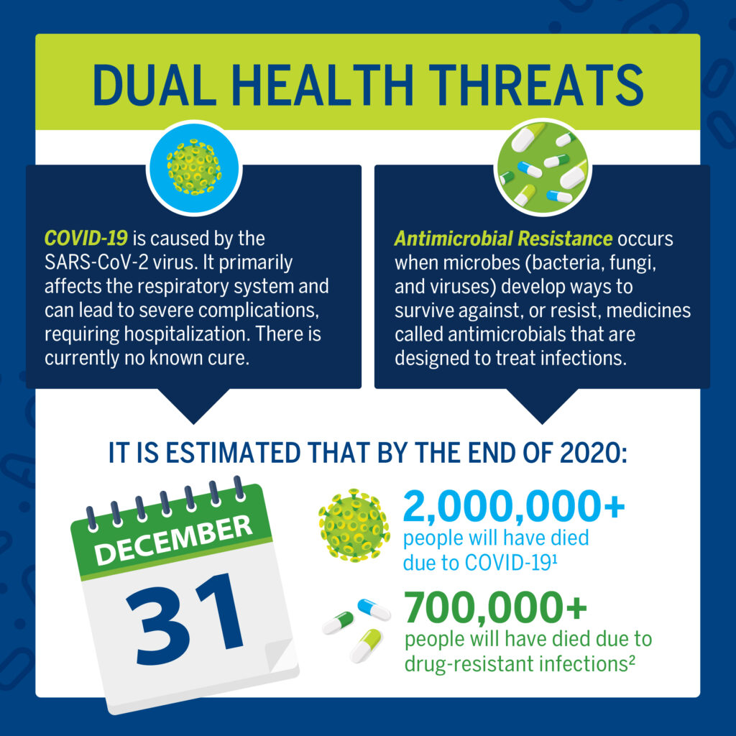
Two Pandemics…

Slide 9
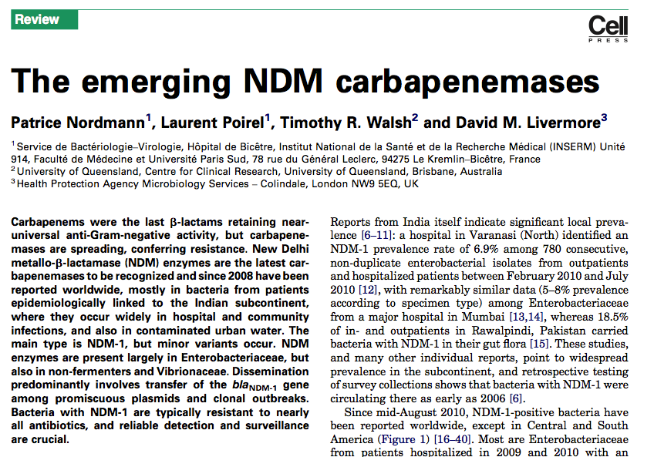
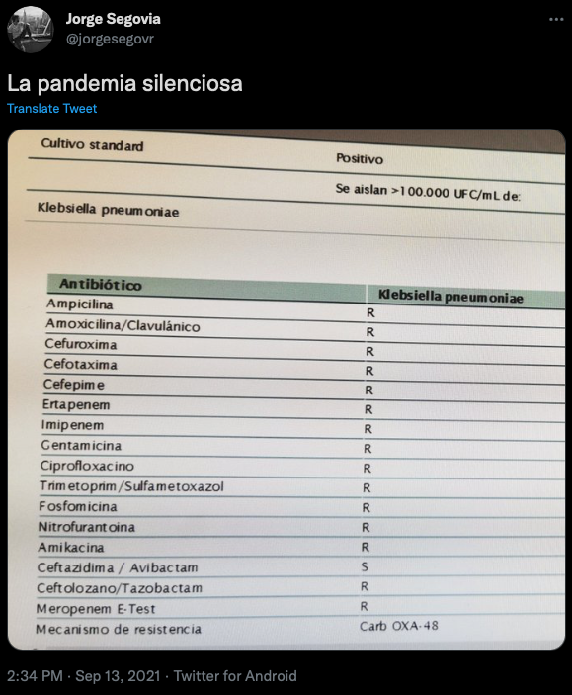

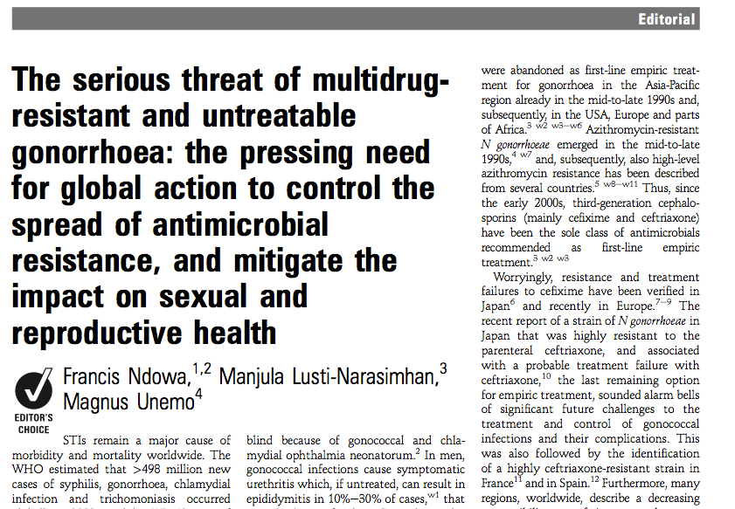
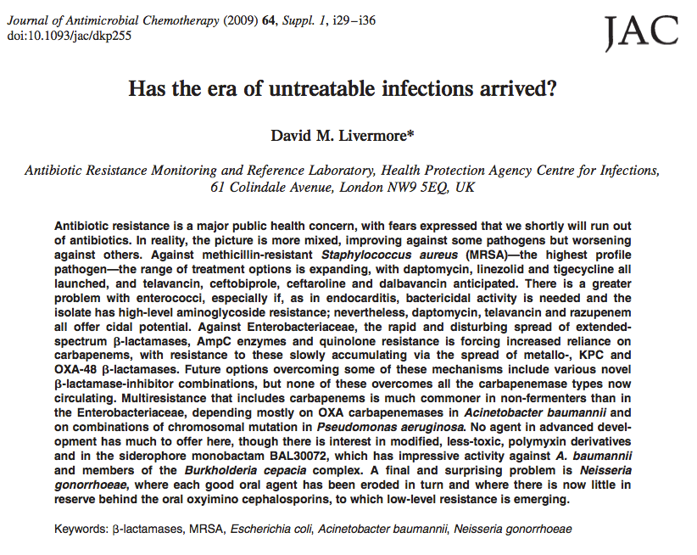
Bacteria are evolving drug resistance faster than we can discover new drugs

Slide 10
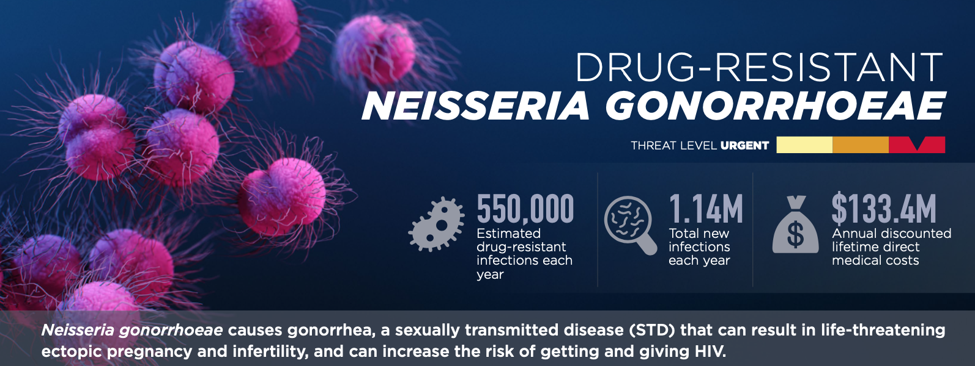
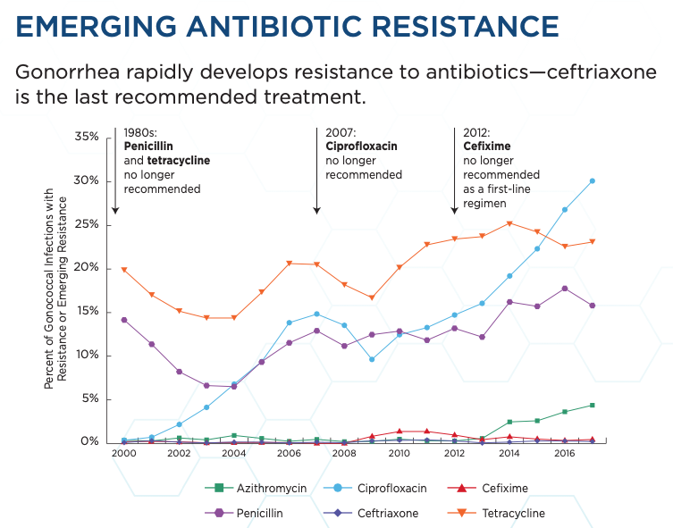
Bacteria are evolving drug resistance faster than we can discover new drugs
CDC’s Antibiotic Resistance Threats in the United States, 2019 https://www.cdc.gov/drugresistance/

Slide 11
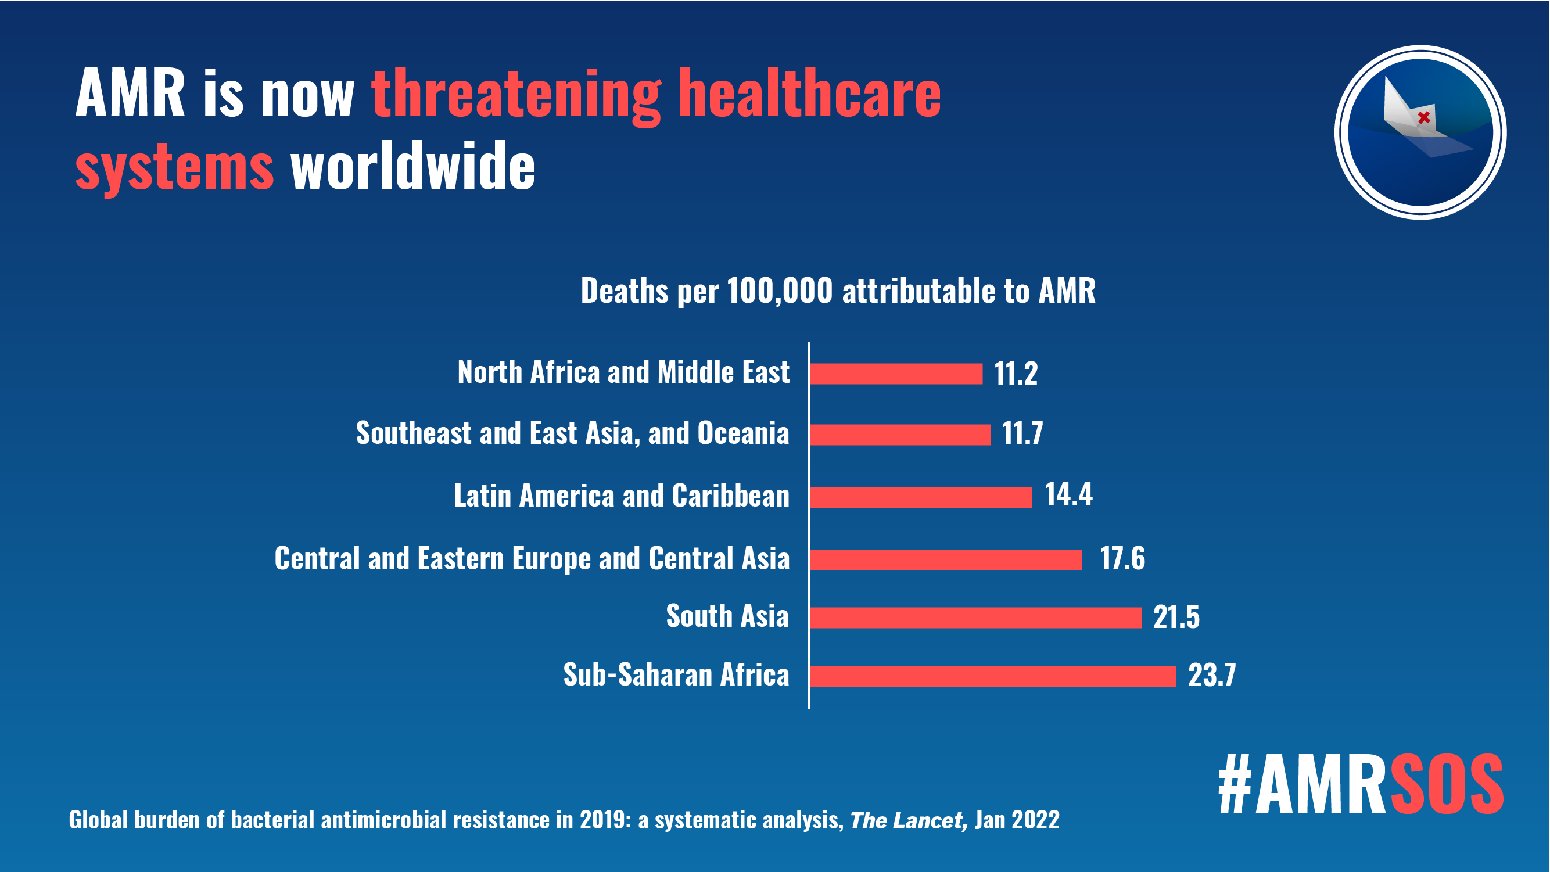
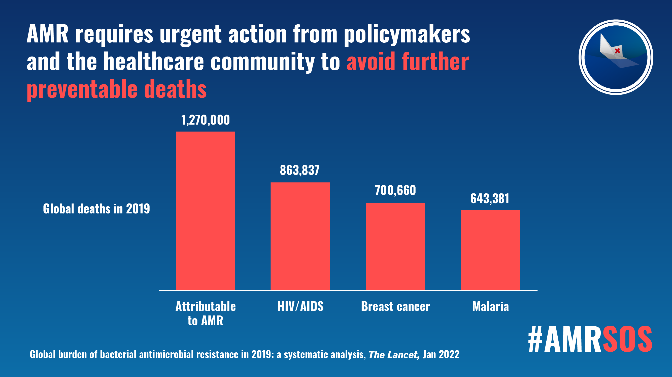
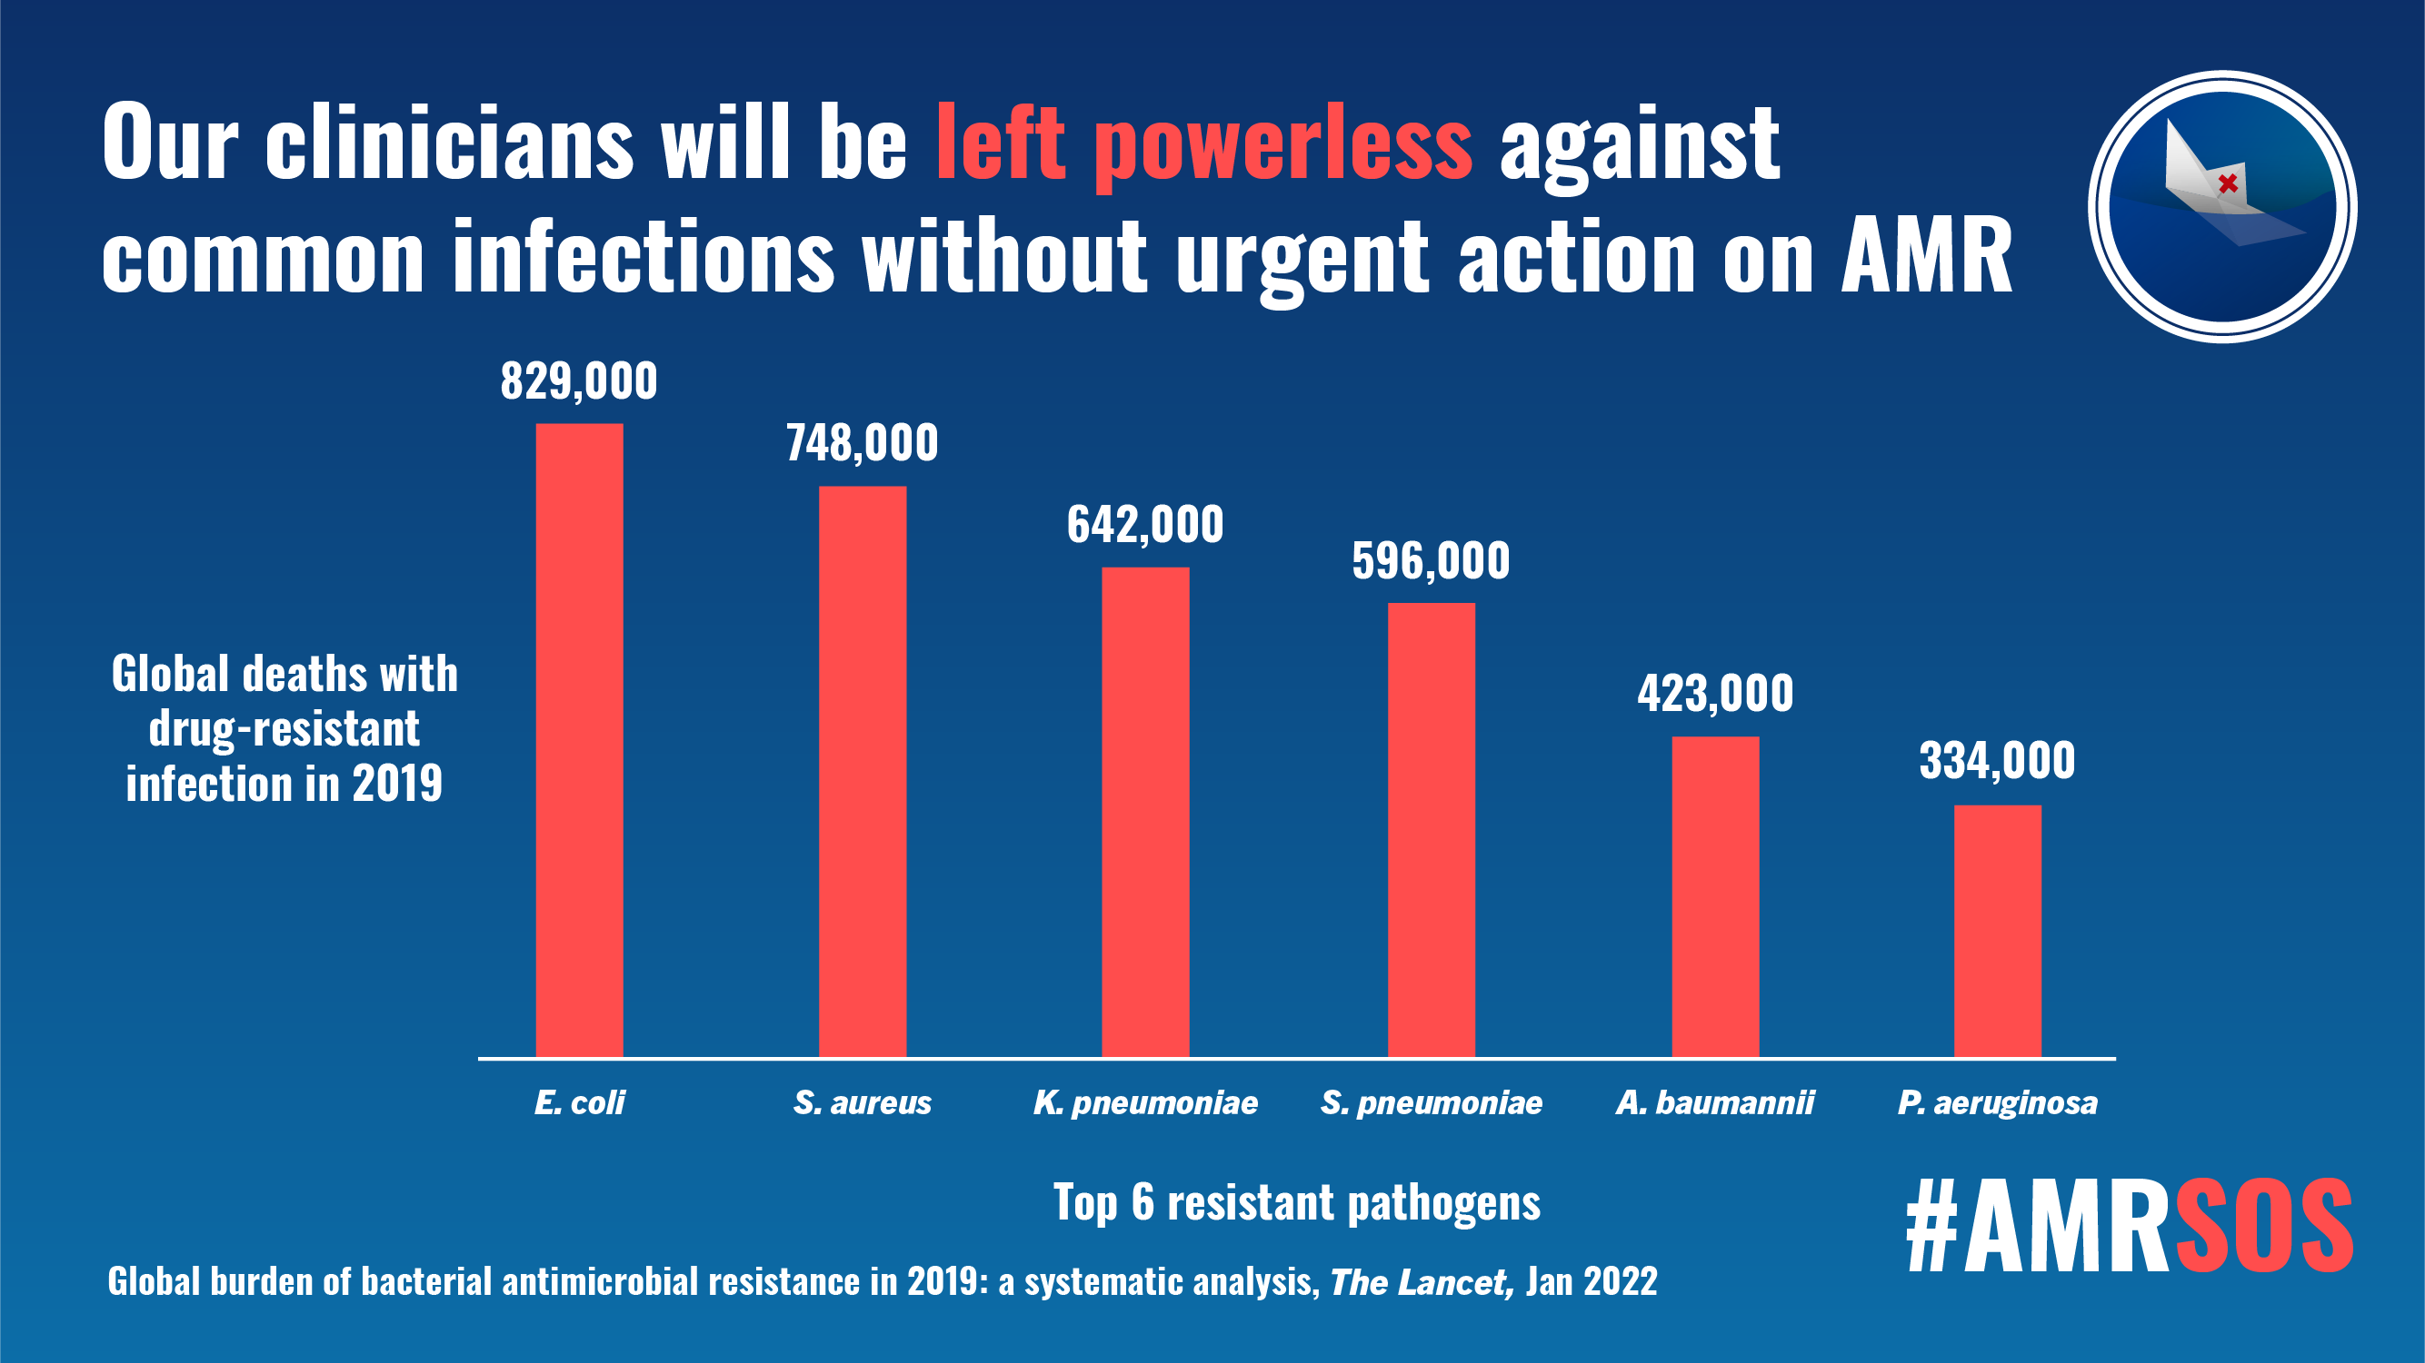
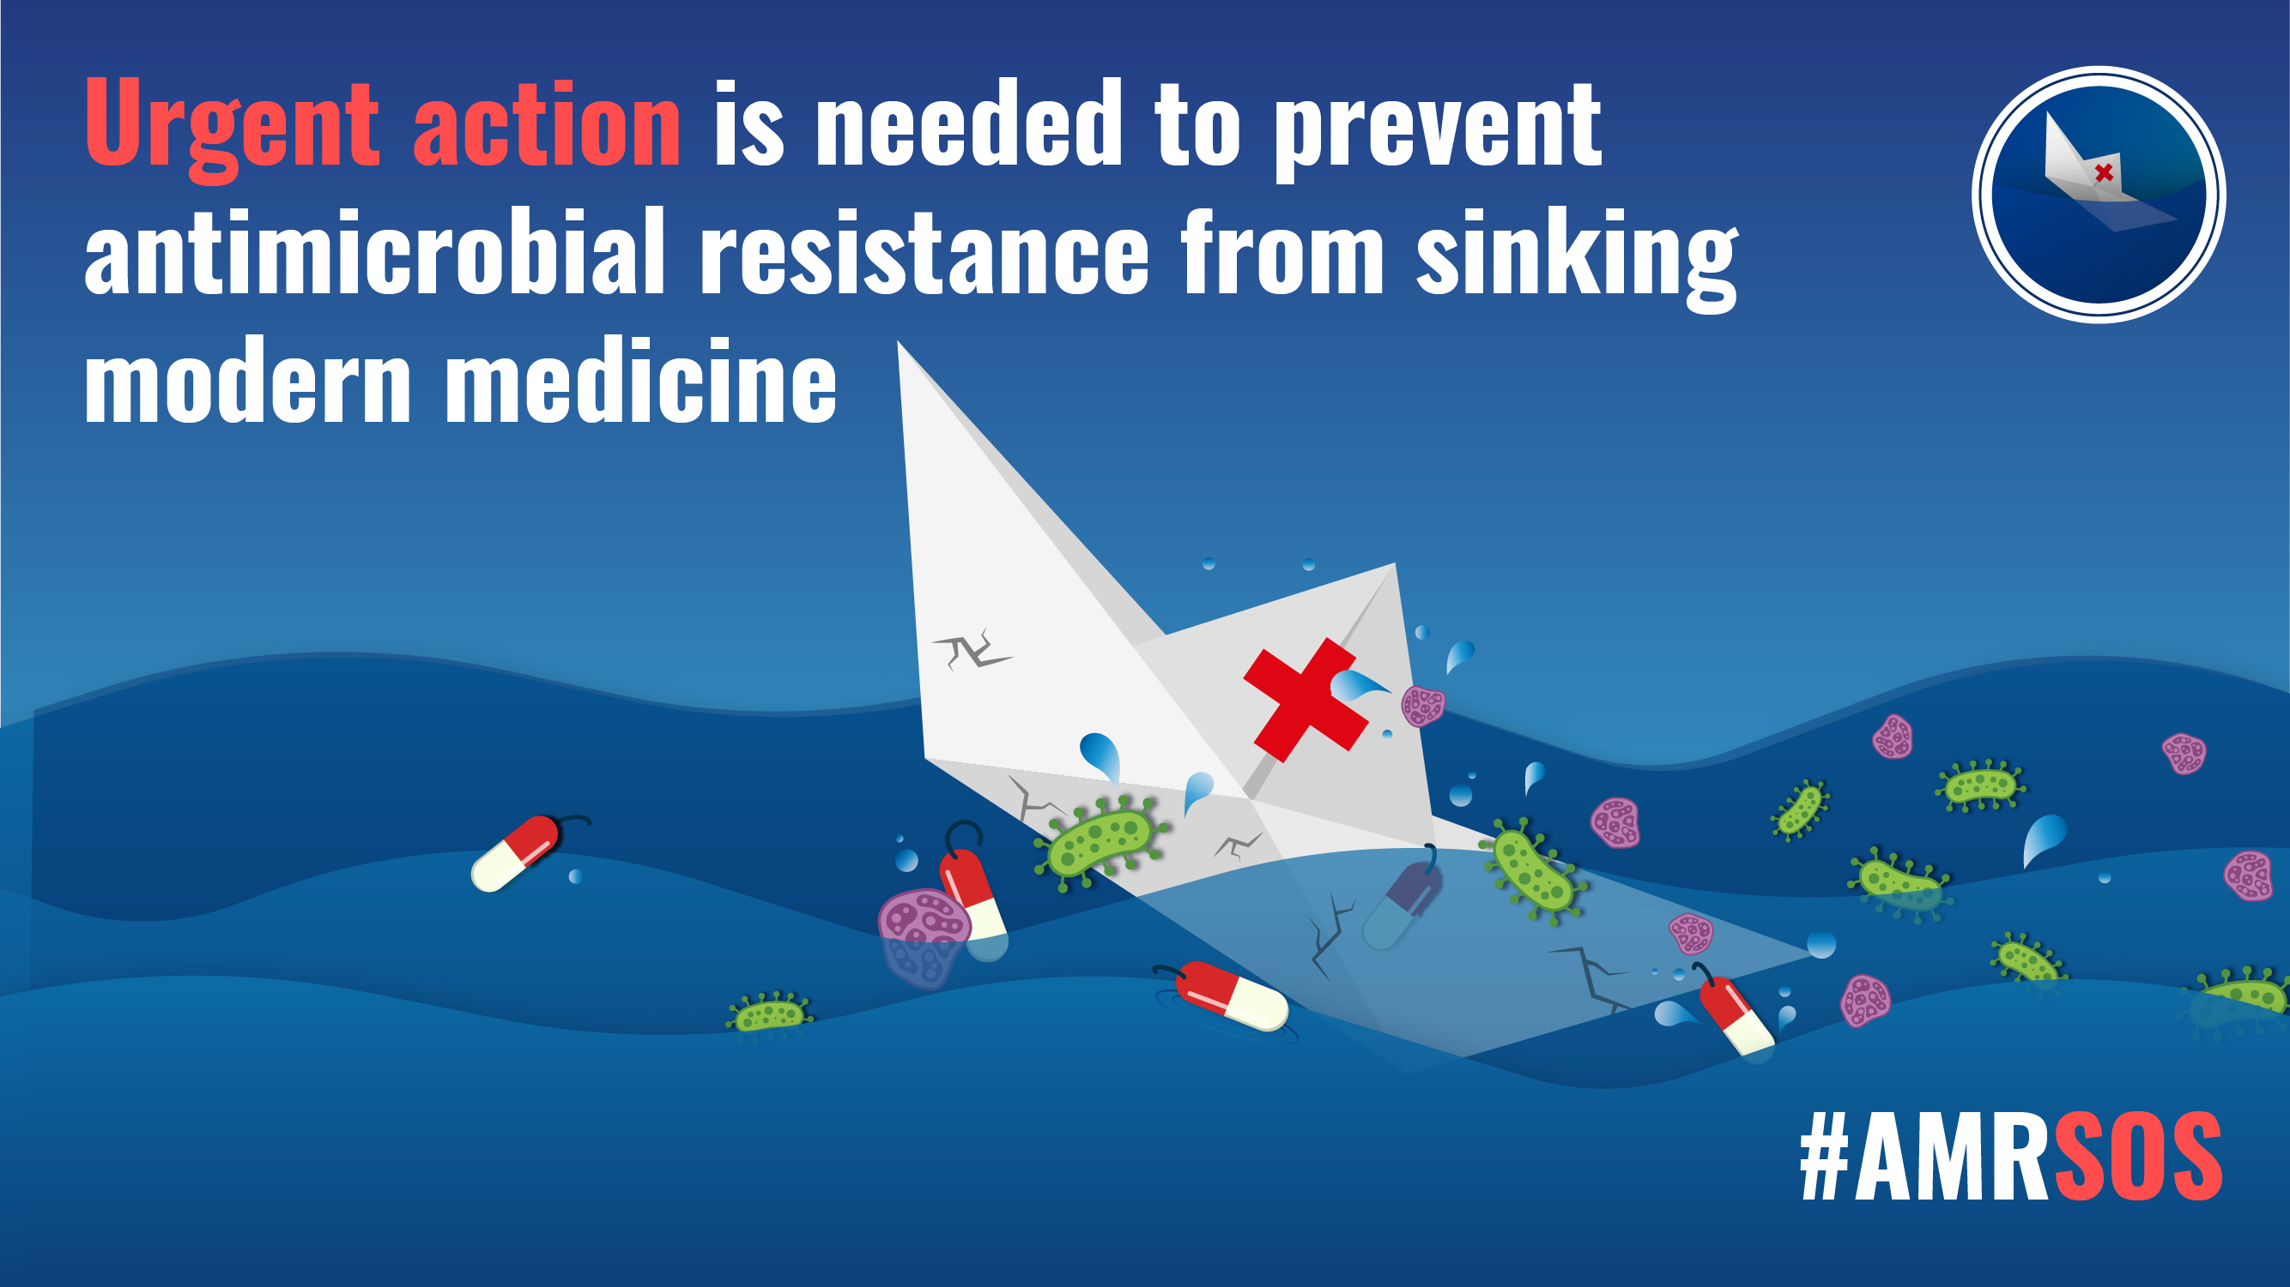
Bacteria are evolving drug resistance faster than we can discover new drugs
Murray et al. 2022. Global burden of bacterial antimicrobial resistance in 2019: a systematic analysis. Lancet 399, 629-655.

Slide 12
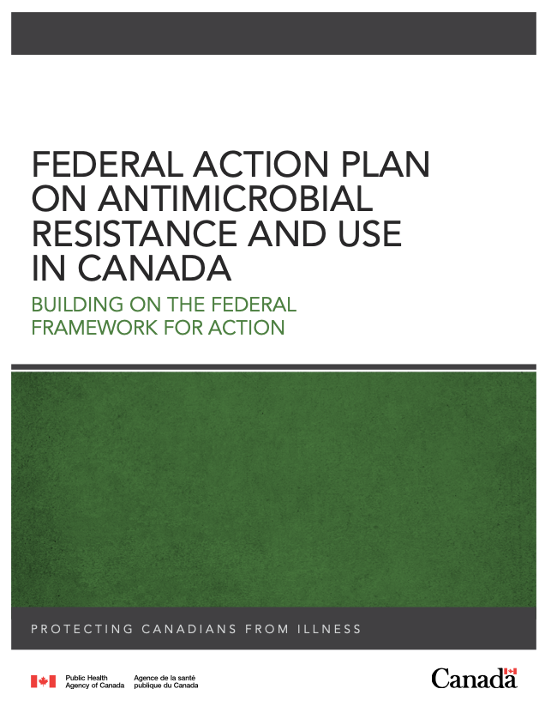
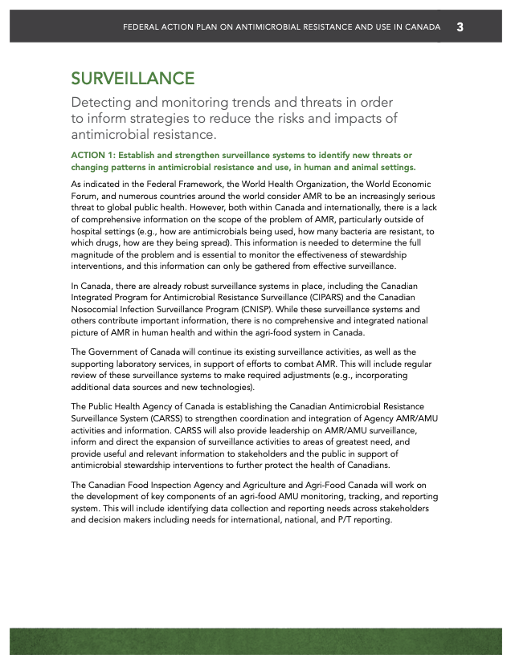
Phenotypic & Genotypic Surveillance is a National & International Priority

Slide 13
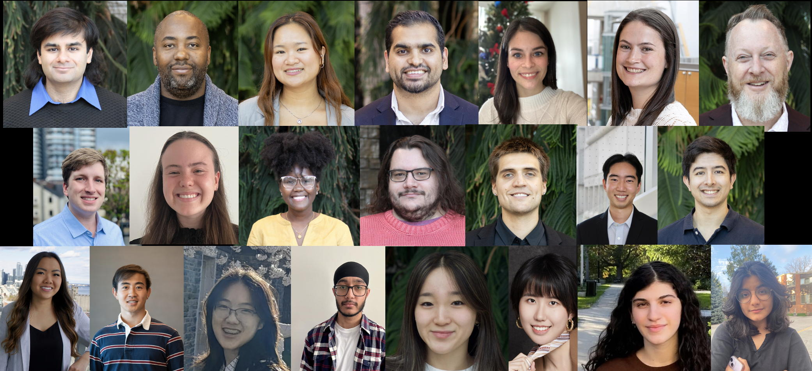
Which resistance genes are in Canada, the Americas, Globally?
Which genes are moving around?
Which pose a threat?

Slide 14
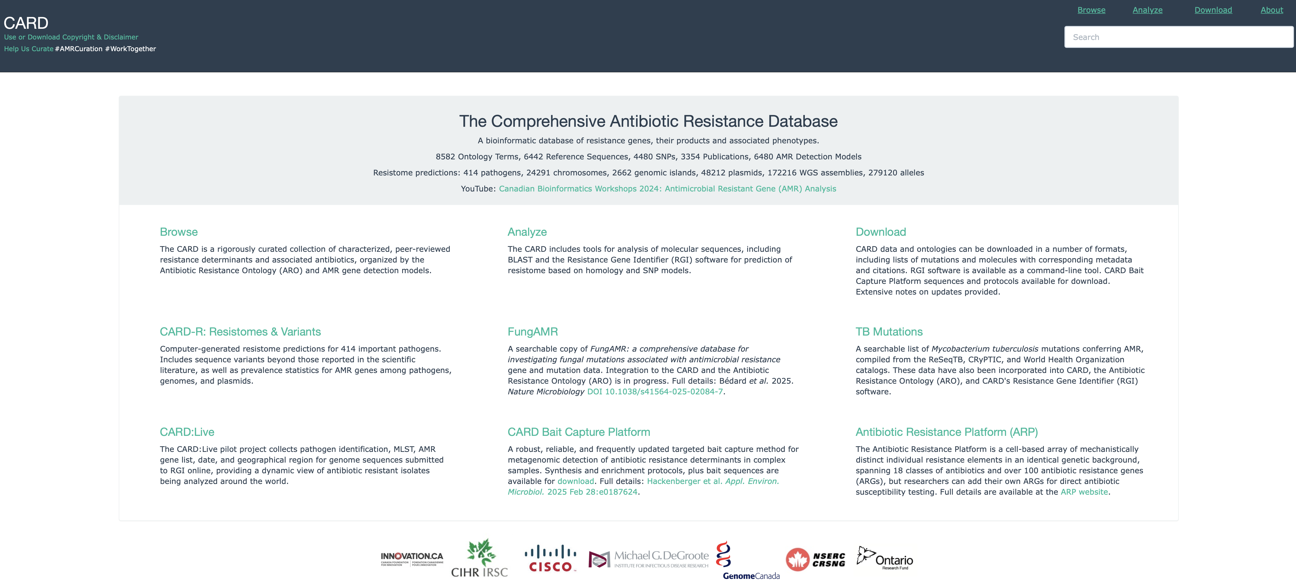
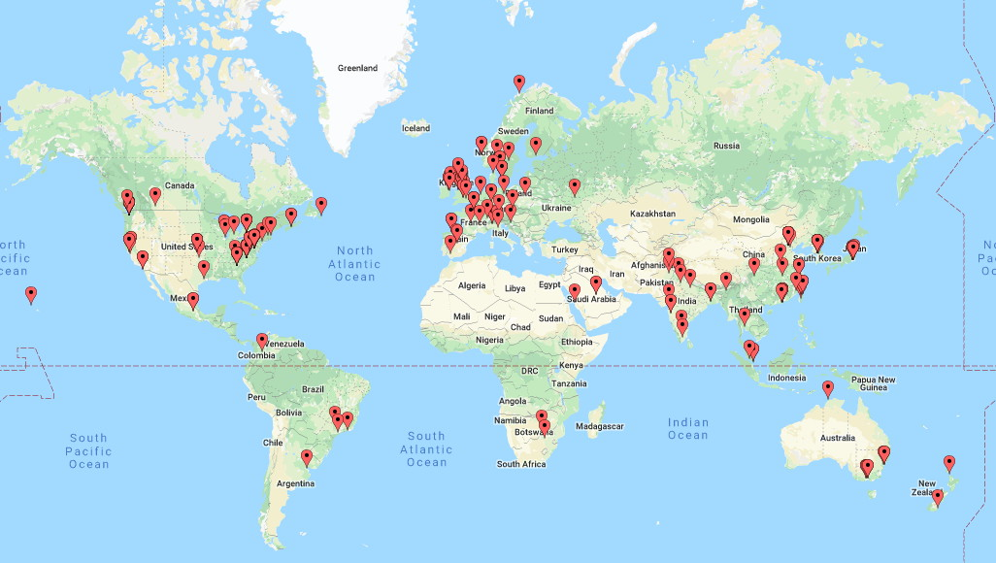
CARD’s primary curation paradigm
Peer reviewed publication in PubMed
Clear experimental evidence of elevated MIC
Public sequence record in GenBank
7 days in the life of CARD…
Alcock et al. CARD 2023: Expanded Curation, Support for Machine Learning, and Resistome Prediction at the Comprehensive Antibiotic Resistance Database. Nucleic Acids Research, in press.

Slide 15
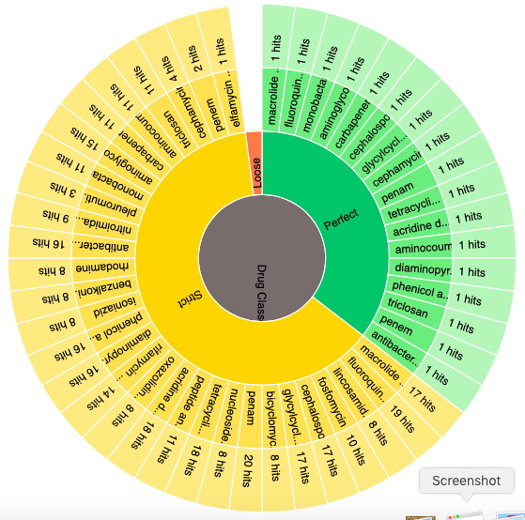
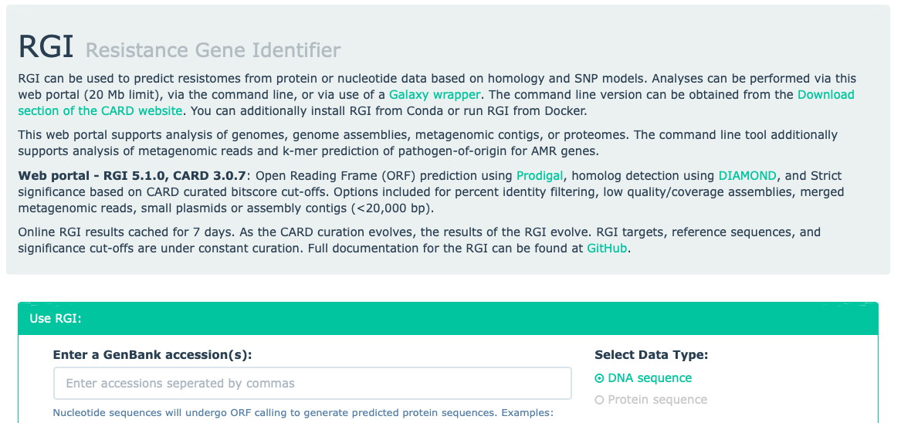
Salmonella genome sequence
CTGTCCCTTGGCTTTTTTTACTATGGTCTCGAAATGAACGTTTGTATGACTTTGCCATCC
GCTTGACGCTCTTCATAGTGATTGGCTGTGTAATCGCGGATGCTCGCACGCCAAAAGCCG
ATGGCAGGCATGTTGTTTTCCAATTGAAAGACTTCCCAGGCACCCGGGAACATTTTGAAG
ATTTGATGGGAGACCGCTTTTCCGATTCCCAGCCGACGGTAGCGTTTCATGATAAAAAAT
TCAGCAATGGAGTGGATCGATGGCAAATTTGCATCAGGGCTTGTGAGCATGCGGACGAGG
ACAAAACCAGCCAGCTTACCATTAACCTTGATGAAAAAGGGATGGCGCTCTGGTTCAACC
CAATATTTCTCAAAGTAGTCGTAGCCAAACAAGCCGTCGTCATCTACTTCGAAAGGCTCA
AACTCAGTGAAGTCGTACGTATACAGCTCCAACAGTTGCTTGAGAGCGTGCTTCTGTTCA
AAAGGAACTCGTTCTATCGAGAATGCTTGATTCACTGAGAAAACCTCCTTTTTTCTTGAG
ATATAGGAGTATCGTACTTTATTTTTTAGGTTGTGGGAACATATGGTGGACACTTCTTTA
TAGAACCTCACACGATTGATCATTTTACTTGAGGTGGTTCCAGTCGGGCTATACTAGAGT
CAAACGAAAGAAAATCAATACGAAGCAAGACAGCAGCCATACGGTGATCAGCCGGGTGGC
TGAATTGTTATTCTTATCTCAATAACAGCCTCGAGAATGTAACAACTGGGAGACGAACGA
CAAATTAATCAACGGAAACATCACATAATAGGATGGCGATGTAAAGTGAAGGTACTTGGT
CATTTCTTTTCTAAAGATGACATGGAGGAAATATCCGTATTAAAAGATCTATGTATTGGG
ATTAGTGTAAATGGTAGTCCTTTTATATGCTTTGAGGTACTAGATGATATTTTTCAGGAA
CGATATAAGCTTAGTCAACTATCAAGAGAAAAATTATTAATAATTGCAGGGCAGTTACAG
CTGTCCCTTGGCTTTTTTTACTATGGTCTCGAAATGAACGTTTGTATGACTTTGCCATCC
GCTTGACGCTCTTCATAGTGATTGGCTGTGTAATCGCGGATGCTCGCACGCCAAAAGCCG
ATGGCAGGCATGTTGTTTTCCAATTGAAAGACTTCCCAGGCACCCGGGAACATTTTGAAG
ATTTGATGGGAGACCGCTTTTCCGATTCCCAGCCGACGGTAGCGTTTCATGATAAAAAAT
TCAGCAATGGAGTGGATCGATGGCAAATTTGCATCAGGGCTTGTGAGCATGCGGACGAGG
ACAAAACCAGCCAGCTTACCATTAACCTTGATGAAAAAGGGATGGCGCTCTGGTTCAACC
CAATATTTCTCAAAGTAGTCGTAGCCAAACAAGCCGTCGTCATCTACTTCGAAAGGCTCA
AACTCAGTGAAGTCGTACGTATACAGCTCCAACAGTTGCTTGAGAGCGTGCTTCTGTTCA
AAAGGAACTCGTTCTATCGAGAATGCTTGATTCACTGAGAAAACCTCCTTTTTTCTTGAG
ATATAGGAGTATCGTACTTTATTTTTTAGGTTGTGGGAACATATGGTGGACACTTCTTTA
TAGAACCTCACACGATTGATCATTTTACTTGAGGTGGTTCCAGTCGGGCTATACTAGAGT
CAAACGAAAGAAAATCAATACGAAGCAAGACAGCAGCCATACGGTGATCAGCCGGGTGGC
TGAATTGTTATTCTTATCTCAATAACAGCCTCGAGAATGTAACAACTGGGAGACGAACGA
CAAATTAATCAACGGAAACATCACATAATAGGATGGCGATGTAAAGTGAAGGTACTTGGT
CATTTCTTTTCTAAAGATGACATGGAGGAAATATCCGTATTAAAAGATCTATGTATTGGG
ATTAGTGTAAATGGTAGTCCTTTTATATGCTTTGAGGTACTAGATGATATTTTTCAGGAA
CGATATAAGCTTAGTCAACTATCAAGAGAAAAATTATTAATAATTGCAGGGCAGTTACAG
CTGTCCCTTGGCTTTTTTTACTATGGTCTCGAAATGAACGTTTGTATGACTTTGCCATCC
GCTTGACGCTCTTCATAGTGATTGGCTGTGTAATCGCGGATGCTCGCACGCCAAAAGCCG
ATGGCAGGCATGTTGTTTTCCAATTGAAAGACTTCCCAGGCACCCGGGAACATTTTGAAG
ATTTGATGGGAGACCGCTTTTCCGATTCCCAGCCGACGGTAGCGTTTCATGATAAAAAAT
TCAGCAATGGAGTGGATCGATGGCAAATTTGCATCAGGGCTTGTGAGCATGCGGACGAGG
ACAAAACCAGCCAGCTTACCATTAACCTTGATGAAAAAGGGATGGCGCTCTGGTTCAACC
CAATATTTCTCAAAGTAGTCGTAGCCAAACAAGCCGTCGTCATCTACTTCGAAAGGCTCA
AACTCAGTGAAGTCGTACGTATACAGCTCCAACAGTTGCTTGAGAGCGTGCTTCTGTTCA
AAAGGAACTCGTTCTATCGAGAATGCTTGATTCACTGAGAAAACCTCCTTTTTTCTTGAG
ATATAGGAGTATCGTACTTTATTTTTTAGGTTGTGGGAACATATGGTGGACACTTCTTTA
TAGAACCTCACACGATTGATCATTTTACTTGAGGTGGTTCCAGTCGGGCTATACTAGAGT
CAAACGAAAGAAAATCAATACGAAGCAAGACAGCAGCCATACGGTGATCAGCCGGGTGGC
TGAATTGTTATTCTTATCTCAATAACAGCCTCGAGAATGTAACAACTGGGAGACGAACGA
CAAATTAATCAACGGAAACATCACATAATAGGATGGCGATGTAAAGTGAAGGTACTTGGT
CATTTCTTTTCTAAAGATGACATGGAGGAAATATCCGTATTAAAAGATCTATGTATTGGG
ATTAGTGTAAATGGTAGTCCTTTTATATGCTTTGAGGTACTAGATGATATTTTTCAGGAA
CGATATAAGCTTAGTCAACTATCAAGAGAAAAATTATTAATAATTGCAGGGCAGTTACAG

Slide 16
DNA Sequencing – Resistance Genes Can No Longer Hide
DNA sequencing
comparison to reference sequences
prediction of
resistome; AMR surveillance
prediction of phenotype; clinical decision making

Slide 17
DNA Sequencing – Resistance Genes Can No Longer Hide
DNA sequencing
comparison to reference sequences
CARD
biocuration
prediction of
resistome; AMR surveillance
Resistance Gene Identifier
bioinformatics
prediction of phenotype; clinical decision making
Machine Learning
analytics

Slide 18
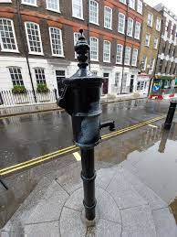
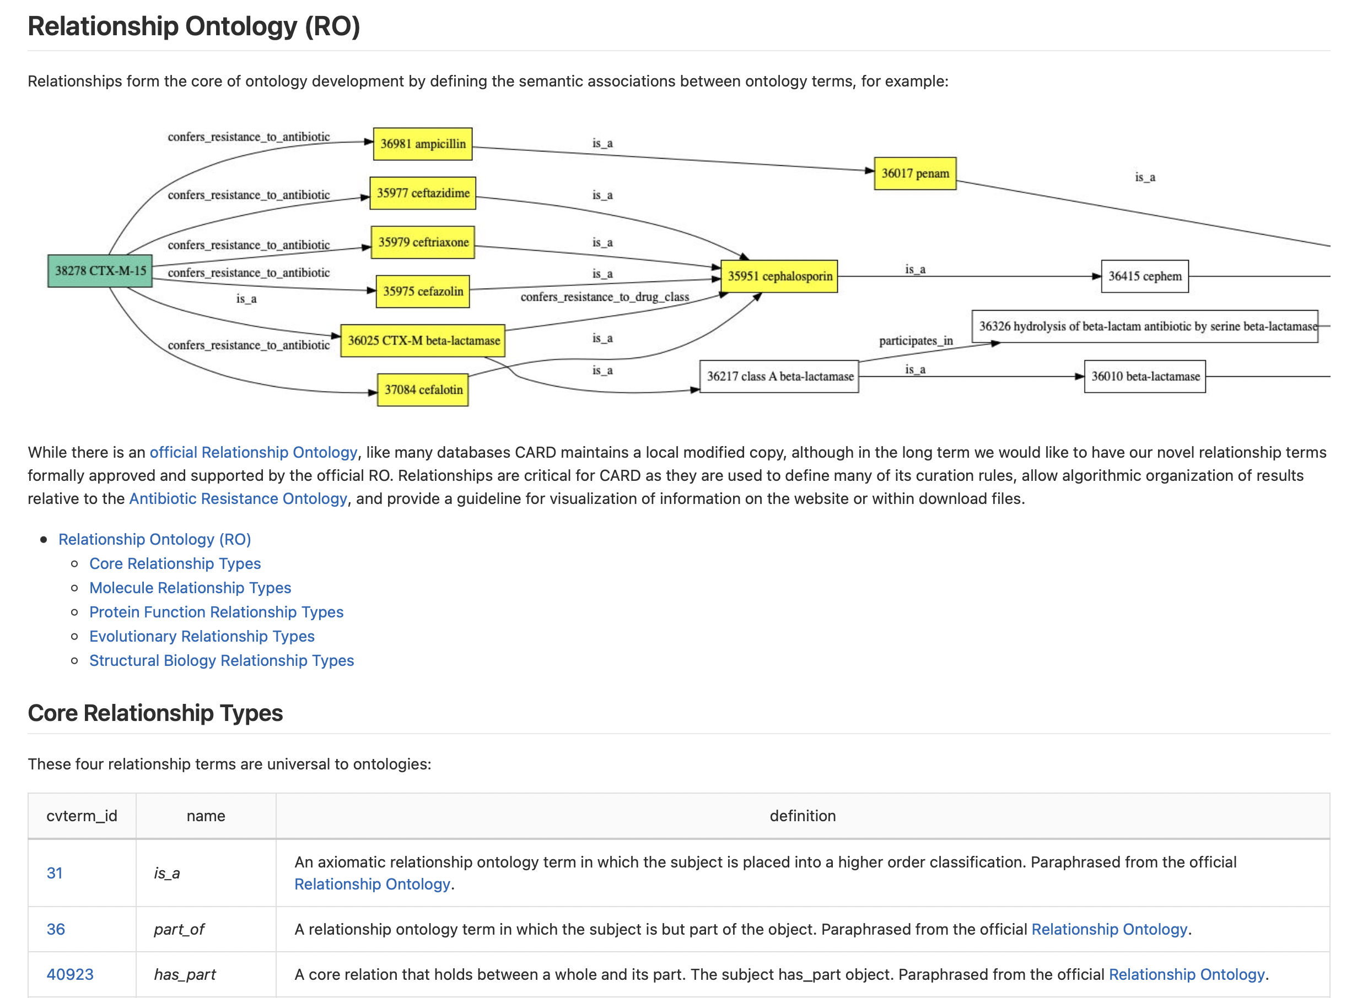

Broad Street Schema has 40M+ rows of data
Frequently Updated
CARD 4.0.1 – May 2025
CARD 4.0.0 – December 2024
CARD 3.3.0 – August 2024
CARD 3.2.9 – February 2024
CARD 3.2.8 – October 2023
CARD 3.2.7 – March 2023
CARD 3.2.6 – January 2023
CARD 3.2.5 – September, 2022
CARD 3.2.4 - July 27, 2022
CARD 3.2.3 - June 14, 2022
CARD 3.2.2 - April 28, 2022
CARD 3.2.1 - April 25, 2022
CARD 3.2.0 - April 4, 2022
…
~204,000 AMR papers in PubMed
~10,000 added AMR papers per year

Slide 19
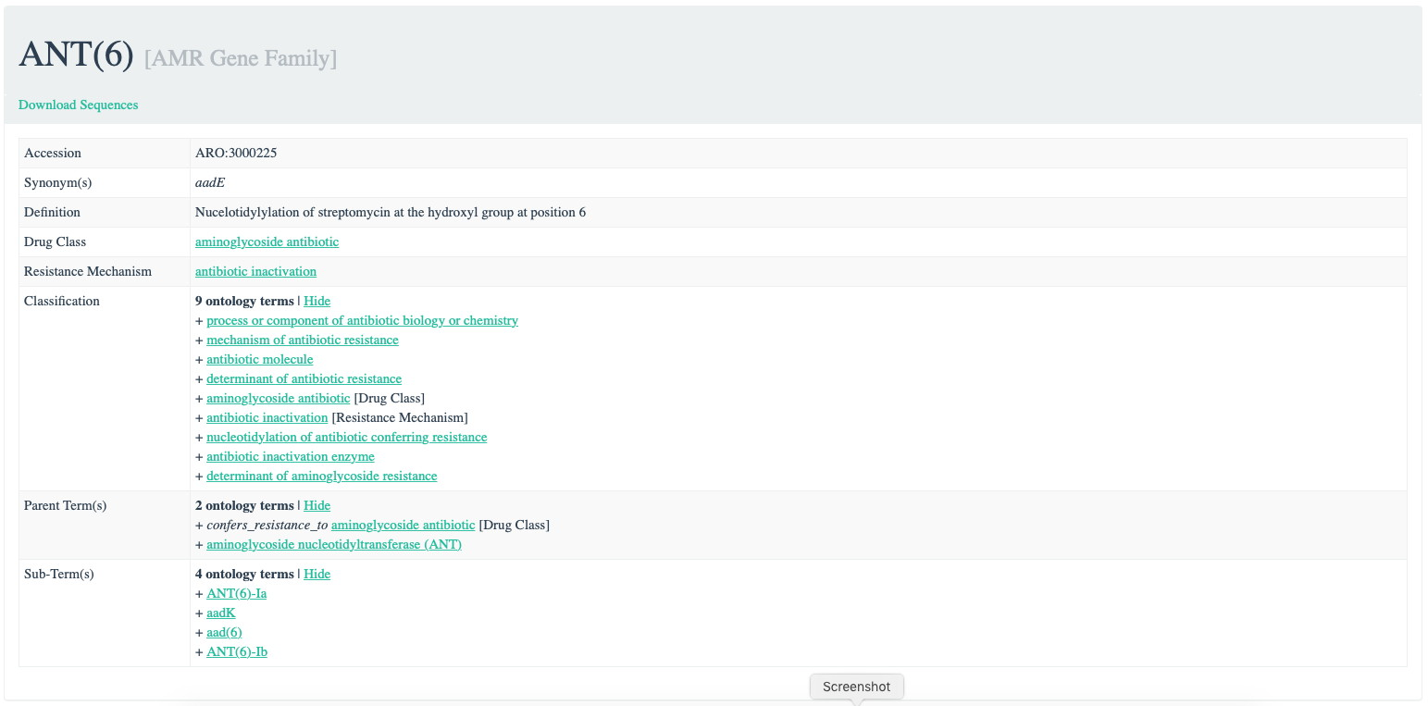
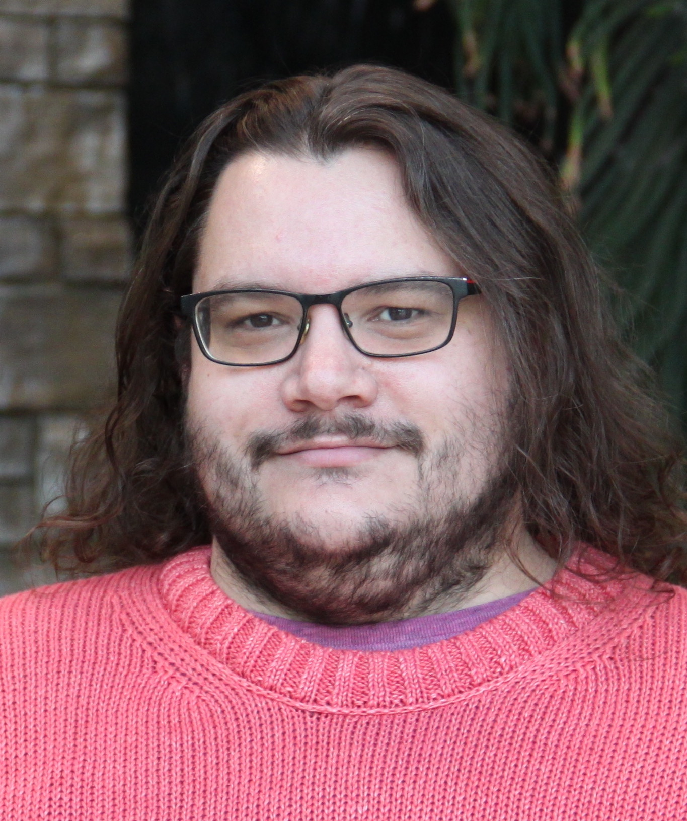
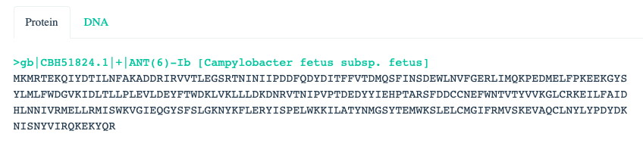
Comprehensive Antibiotic Resistance Database
card.mcmaster.ca
Brian Alcock, Lead CARD Curator
Antibiotic Resistance Ontology knowledgebase

Slide 20
Comprehensive Antibiotic Resistance Database
card.mcmaster.ca
Classification:
AMR Gene Family
Resistance Mechanism
Drug Class
Brian Alcock, Lead CARD Curator
Highly Curated:
AMR Gene Family -> Drug Class
Less Curated:
AMR Gene/Mutation -> Antibiotic, MICs

Slide 21
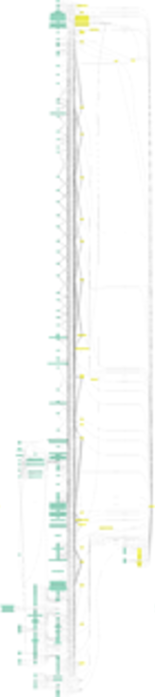
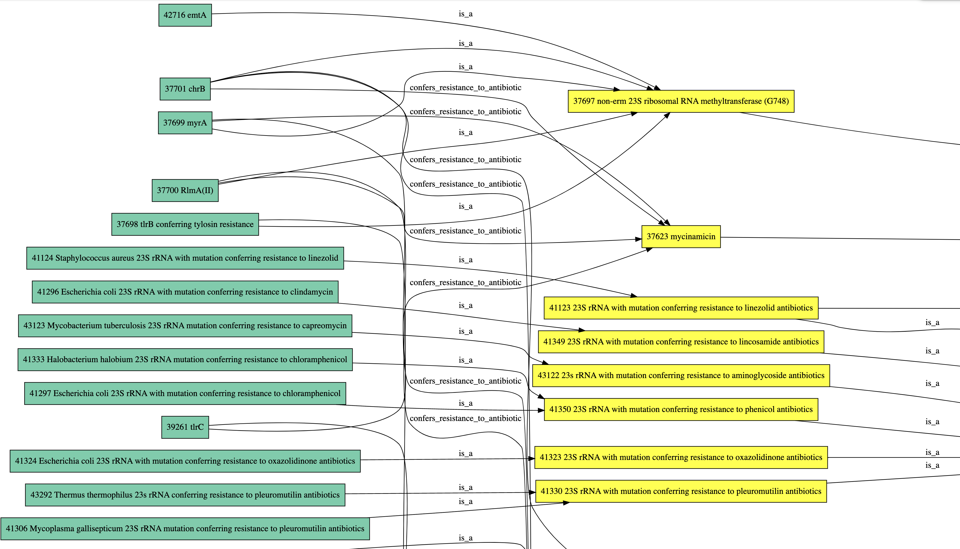
‘Semantic Web’ technologies

Slide 22


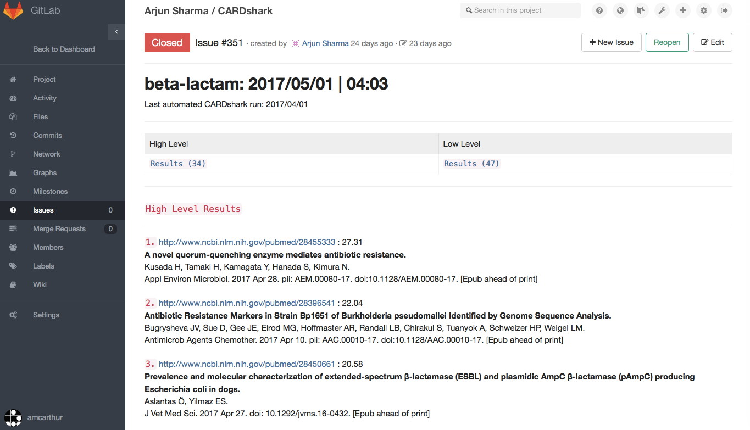
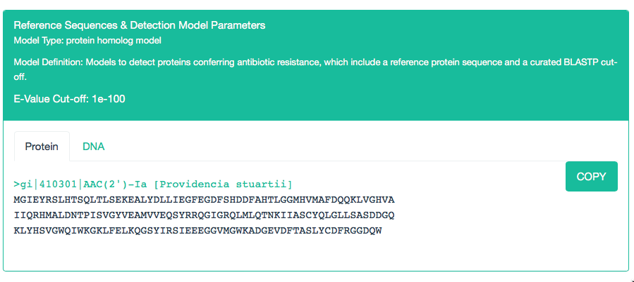
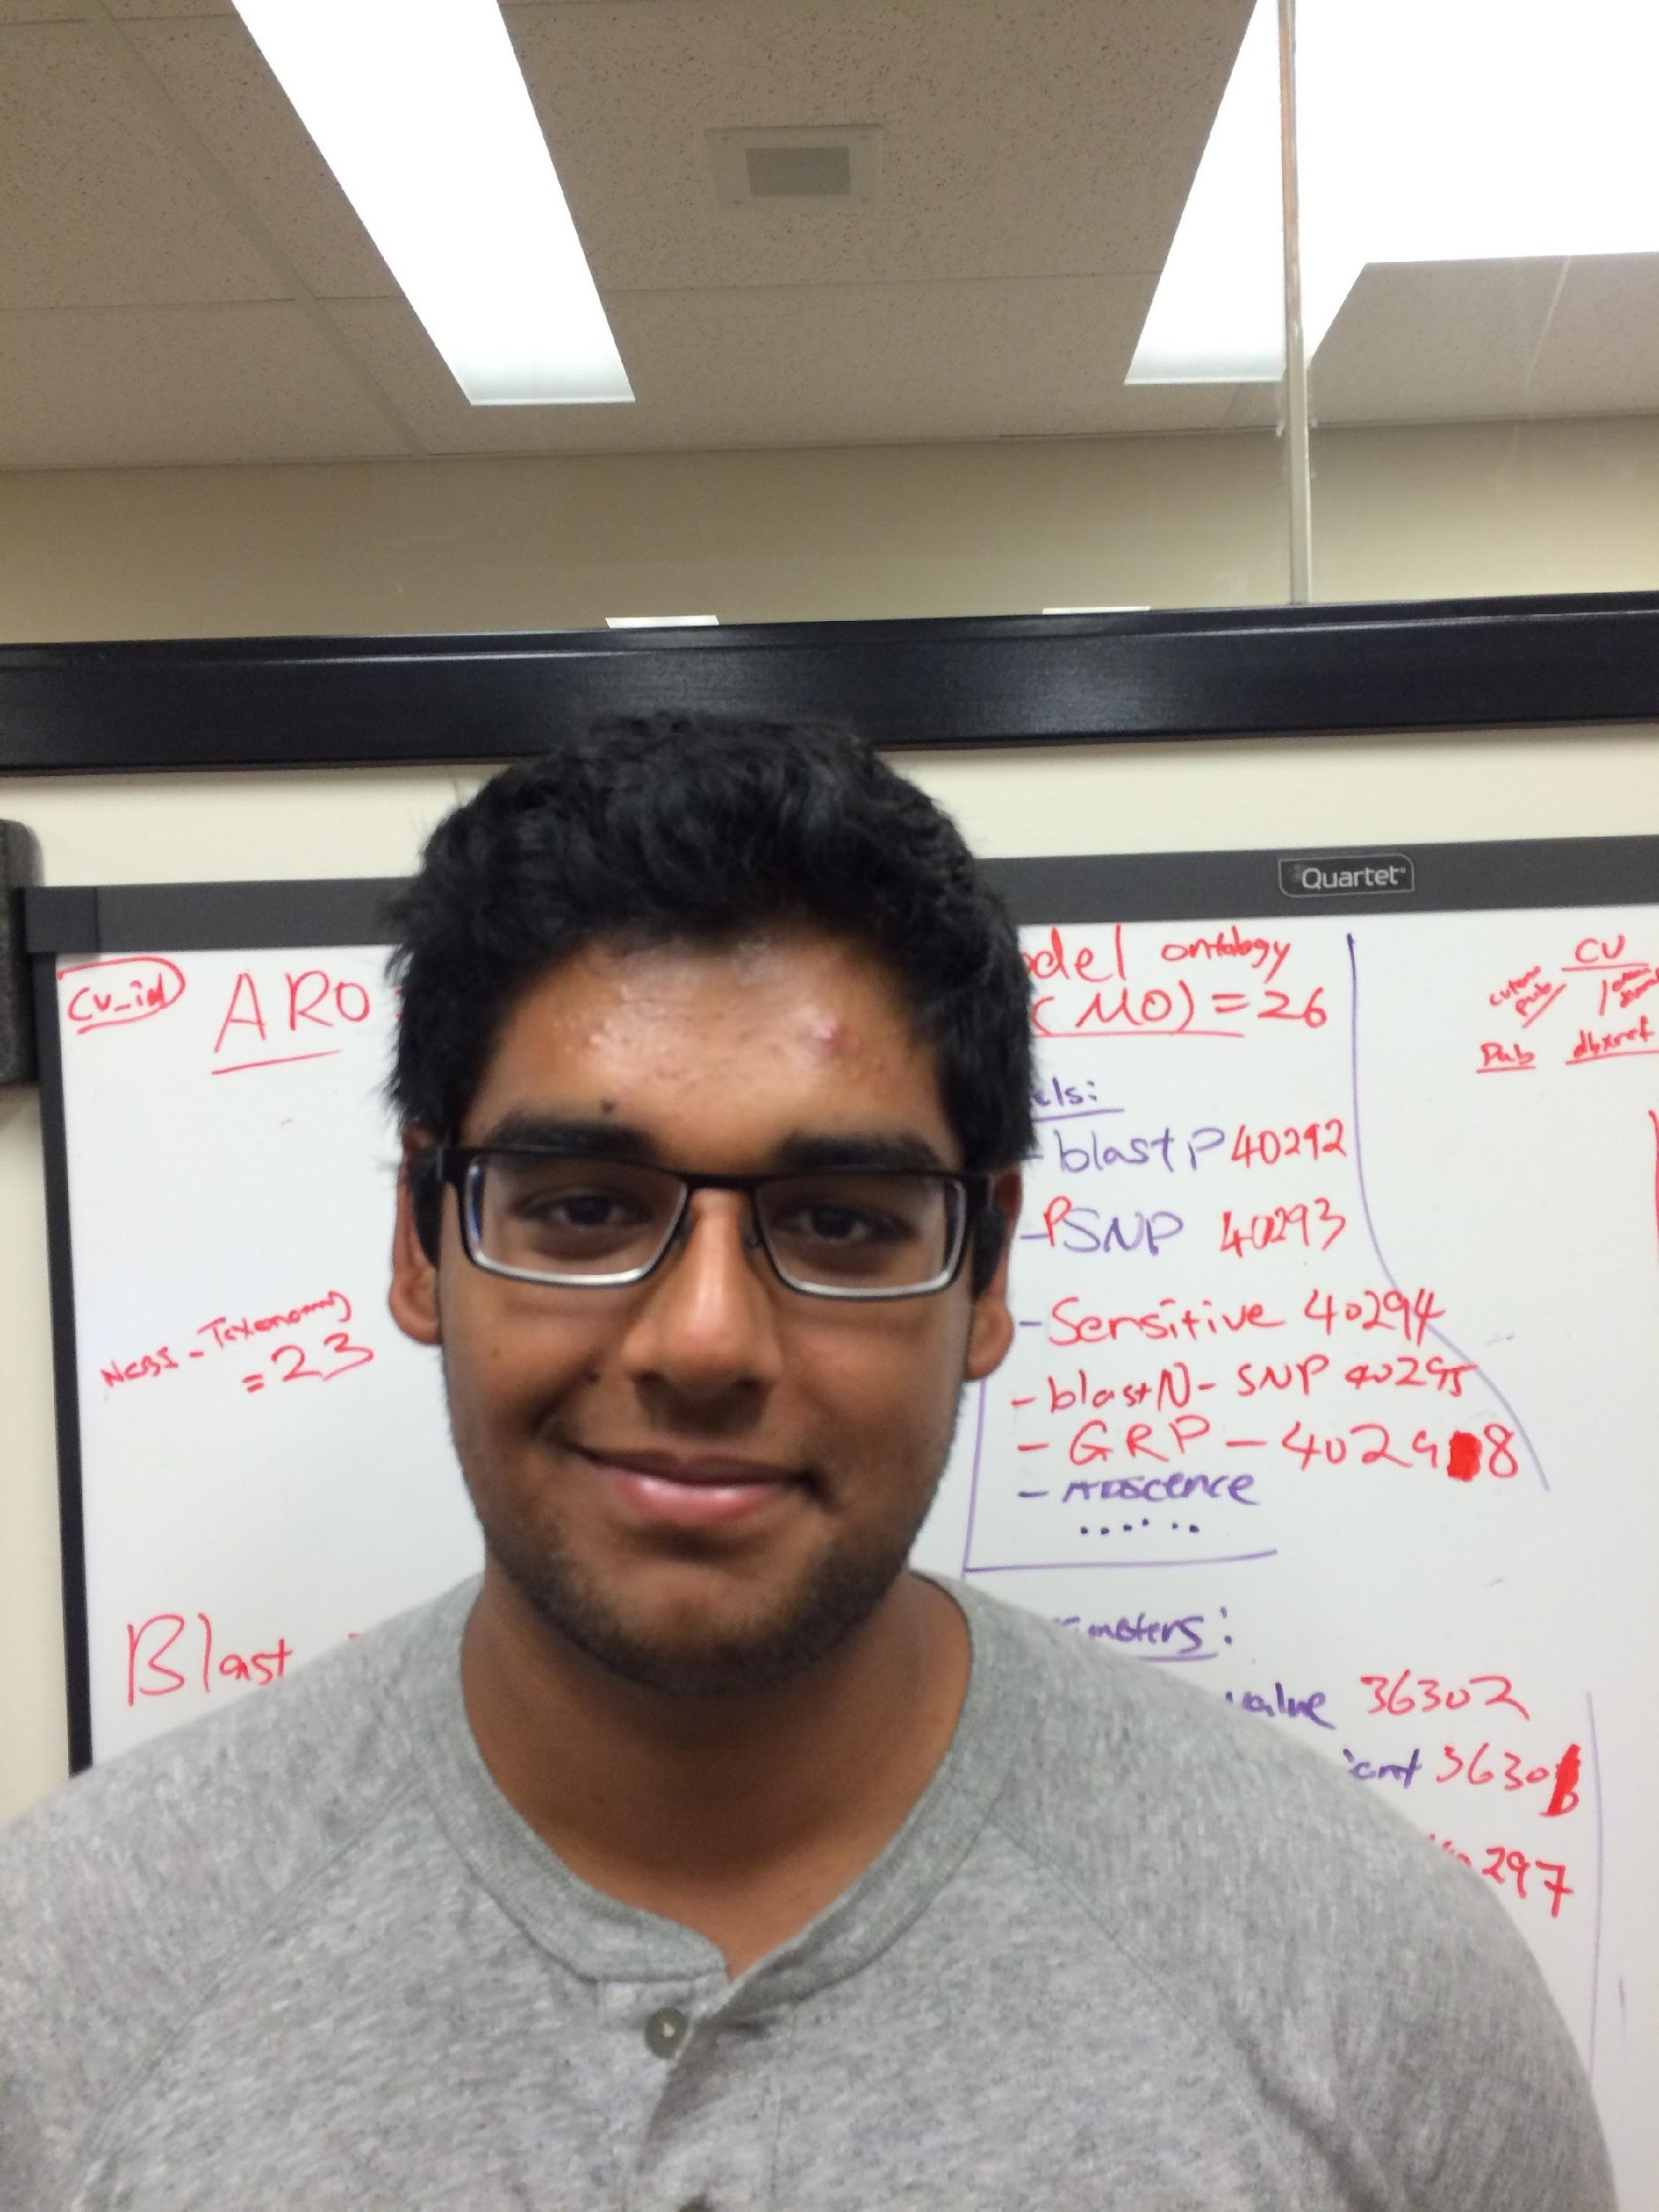
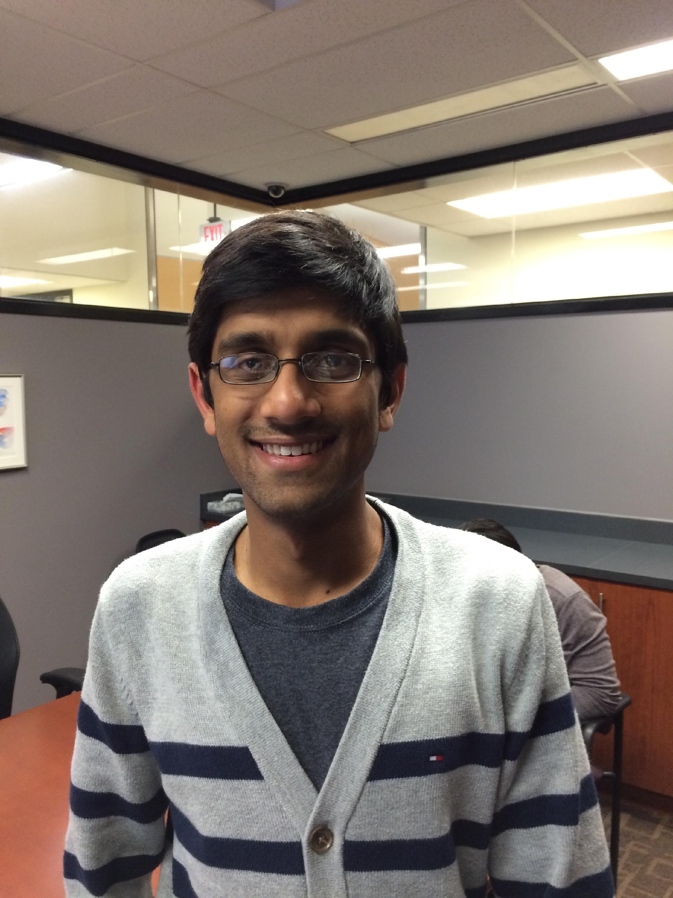
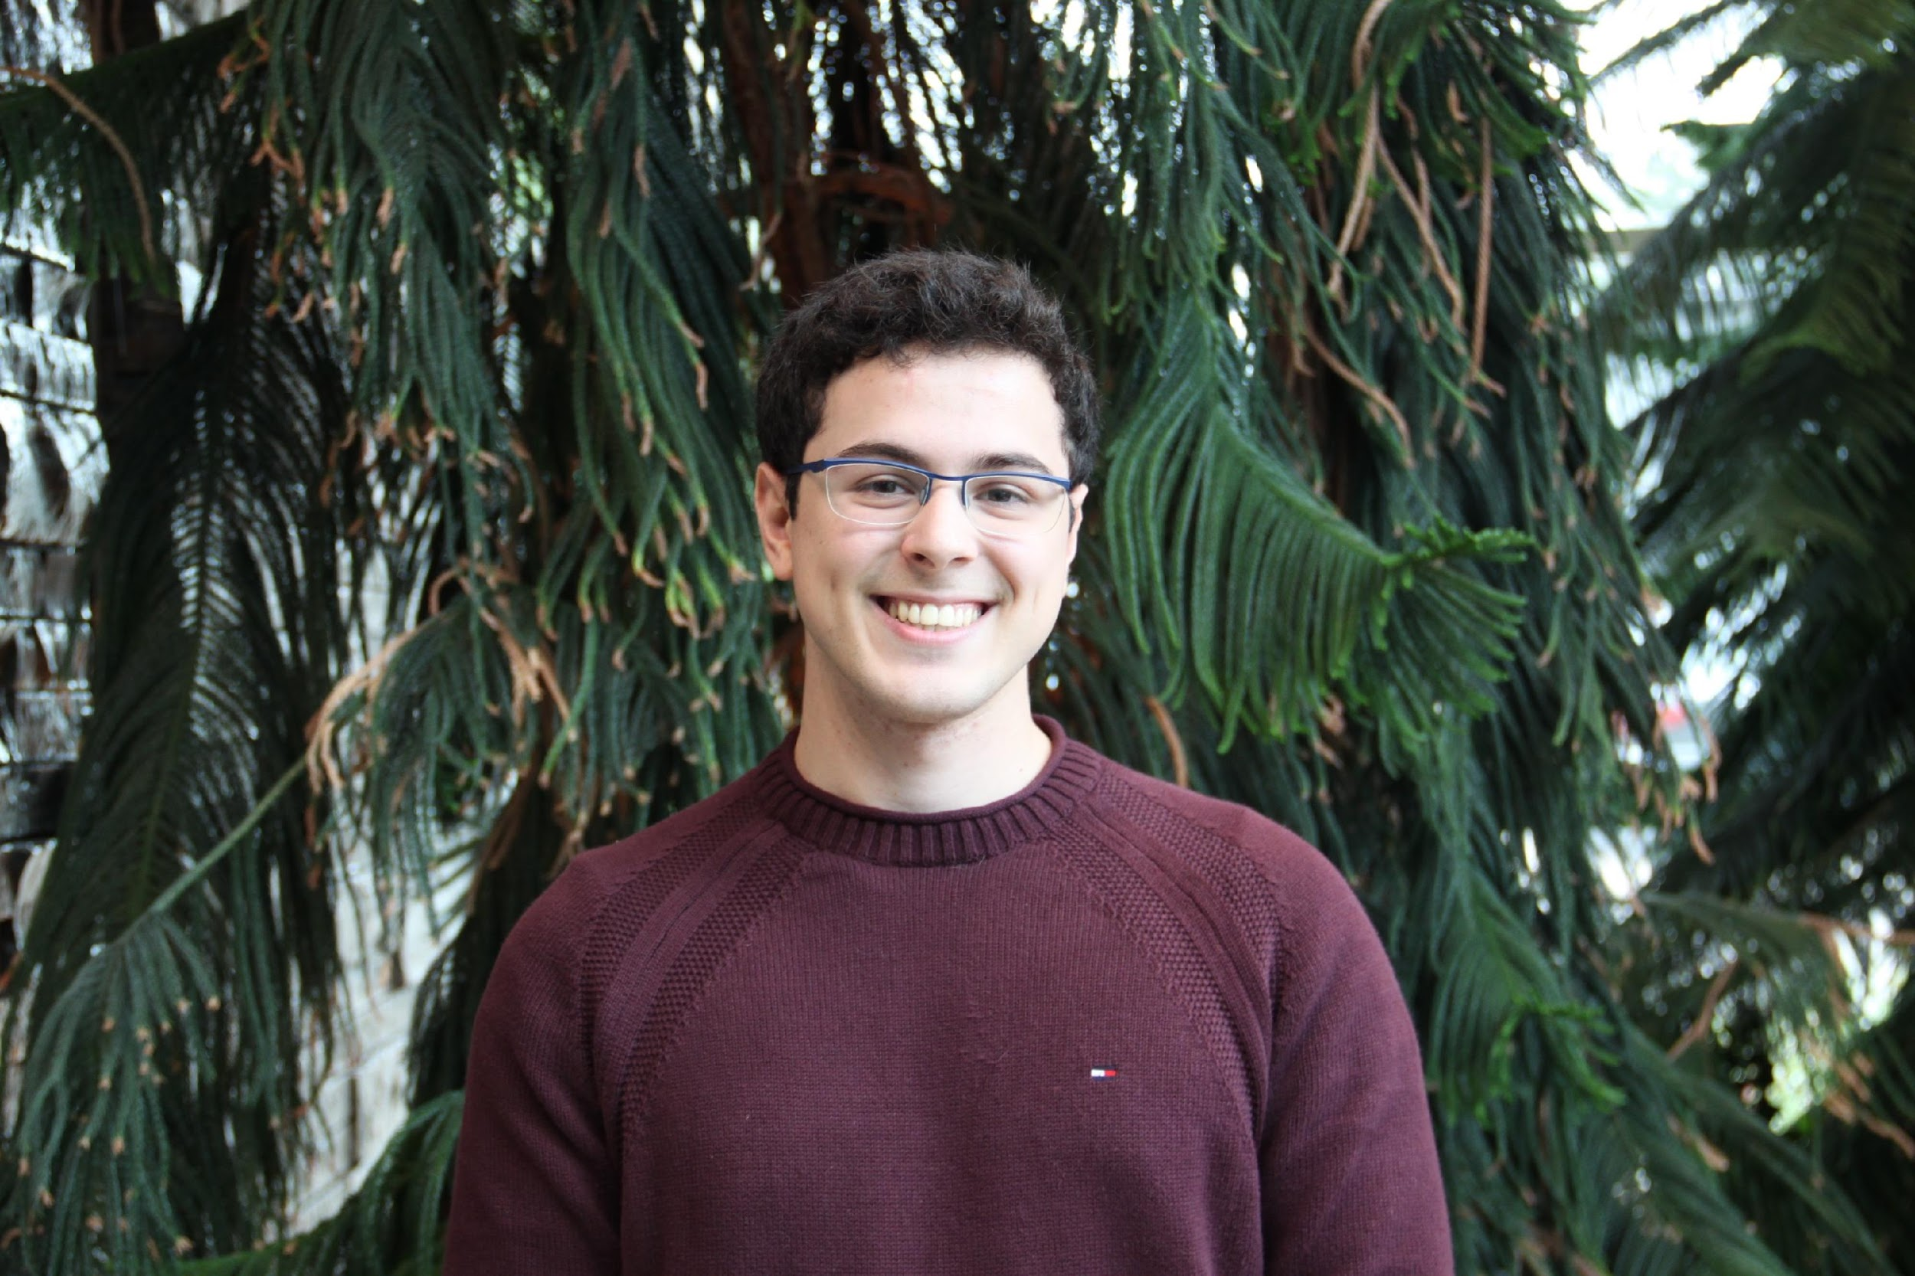
What gets into CARD?
~10000 AMR publications per year
CARD*Shark 2 & 3 text mining algorithms to prioritize and triage AMR literature
human curation
CARD
Arjun Sharma & Sachin Doshi, Biochem ‘17
AMR detection model with reference sequence, cut-offs, and parameters
Reference sequence must be published and have GenBank accession
Publication must have clear evidence of resistance
Arman Edalatmand, Biochem ’20, MSc 2022

Slide 23
PROBLEMS
Culture is not always possible or quick
Genome assembly is computationally intensive & not error free
How do we predict all AMR genes & mutations accurately?
What about the unknown?
Which genes or mutations are driving clinical outcomes?

Slide 24
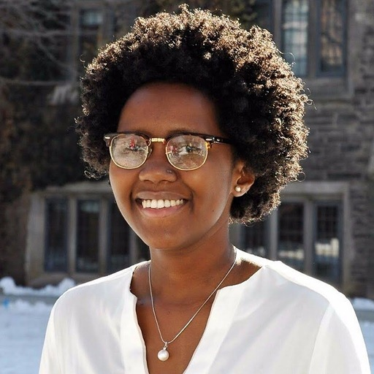
Resistance Gene Identifier
protein homolog model
e.g. extended spectrum beta-lactamase
protein variant model
*
e.g. fluoroquinolone resistant gyrB
rRNA gene variant model
*
e.g. hygromycin B resistant 23S rRNA
protein overexpression model
*
e.g. upregulated MDR in Pseudomonas
protein knockout model
e.g. imipenem resistance in A. baumannii
nonfunctional insertion model
gene cluster meta-model
e.g. vancomycin resistance
efflux pump system meta-model
Karyn Mukiri, PhD Student

Slide 25

Resistance Gene Identifier
perfect
matches reference
sequence
“known known”
strict
similarity within
model
“known unknown”
loose / discovery
“unknown unknown”
similarity outside
of model

Slide 26
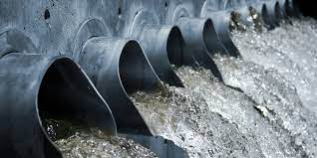
Metagenomics – Culture free sequencing
AMR genes are the needle in the haystack
It takes a lot of (expensive) DNA sequencing
The data is very fragmentary
Analysis sensitive to the diversity of reference data
Even if we find an AMR gene, which bacteria did it come from?
host
microbiome
AMR

Slide 27
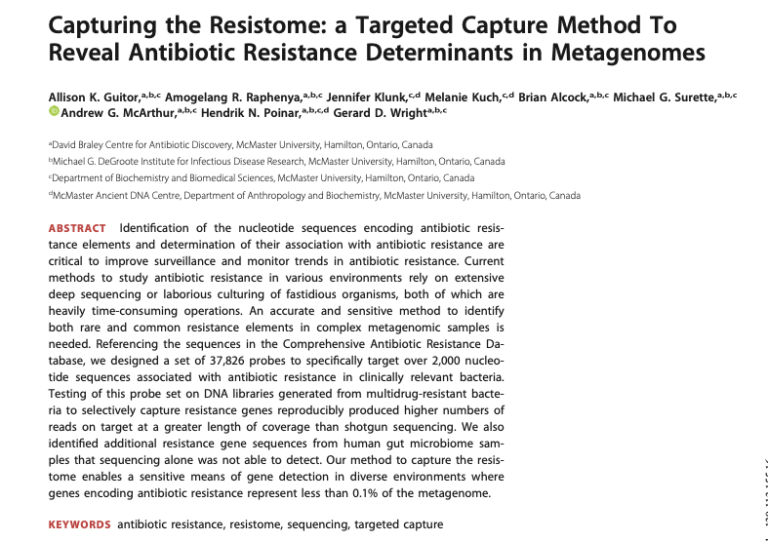
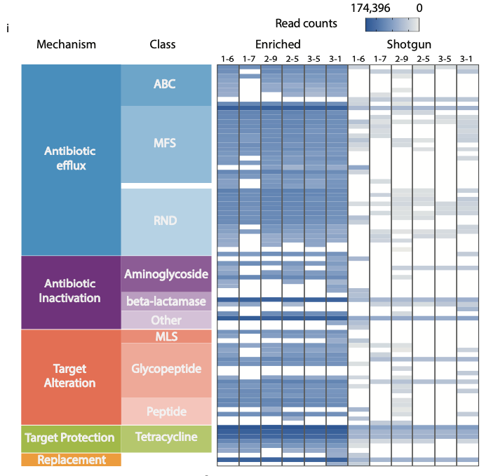
Metagenomics – Culture free sequencing
Guitor et al. 2019 Capturing the Resistome: A robust and reliable targeted capture method for detecting antibiotic resistance determinants. Antimicrobial Agents & Chemotherapy, 64, e01324

Slide 28
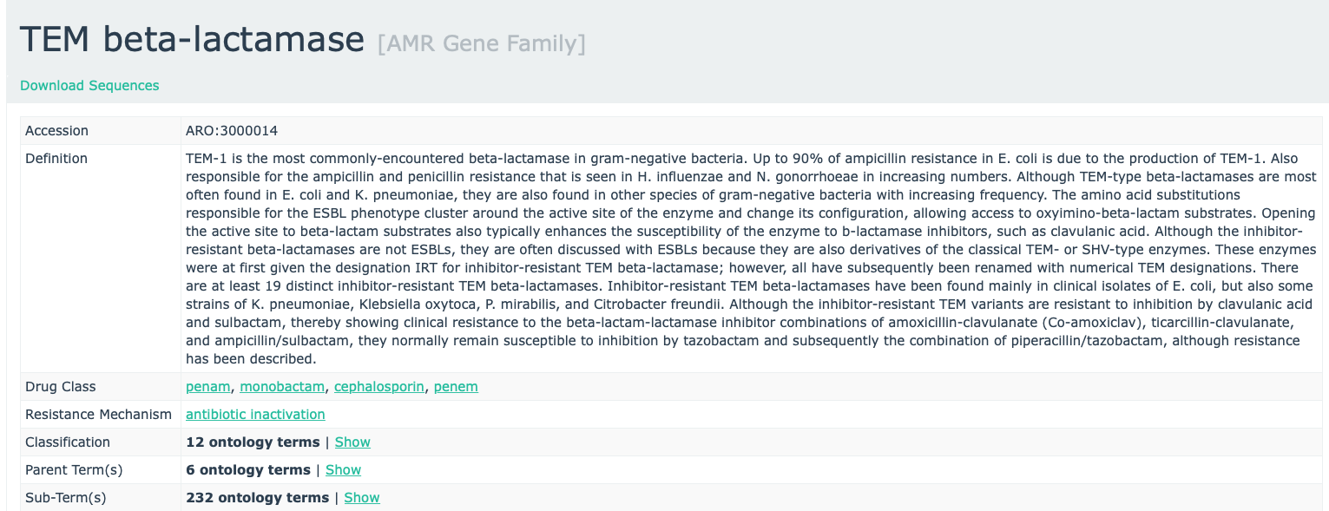
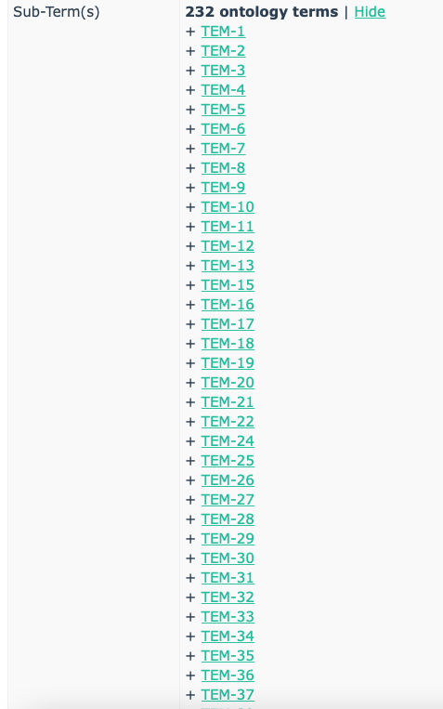
Metagenomics – Culture free sequencing
The AMR Allele Network Problem

Slide 29
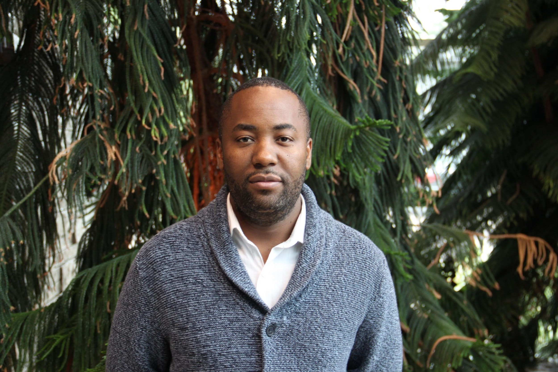
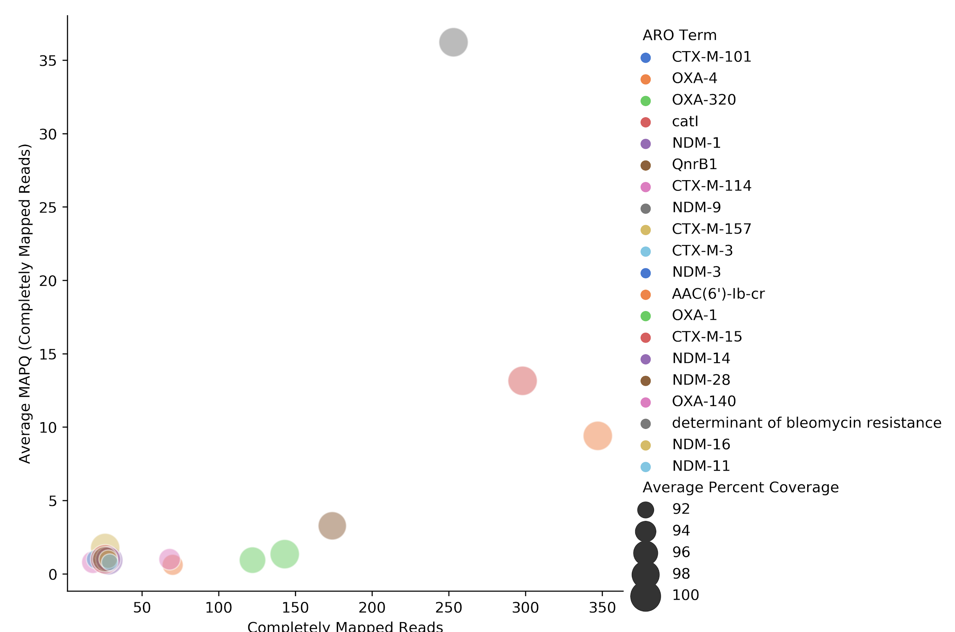
Metagenomics – Culture free sequencing
The AMR Allele Network Problem
Simulated genome (10x coverage) – Bowtie2
catB3
Amos Raphenya, Lead CARD Developer
AAC(6’)-1b

Slide 30
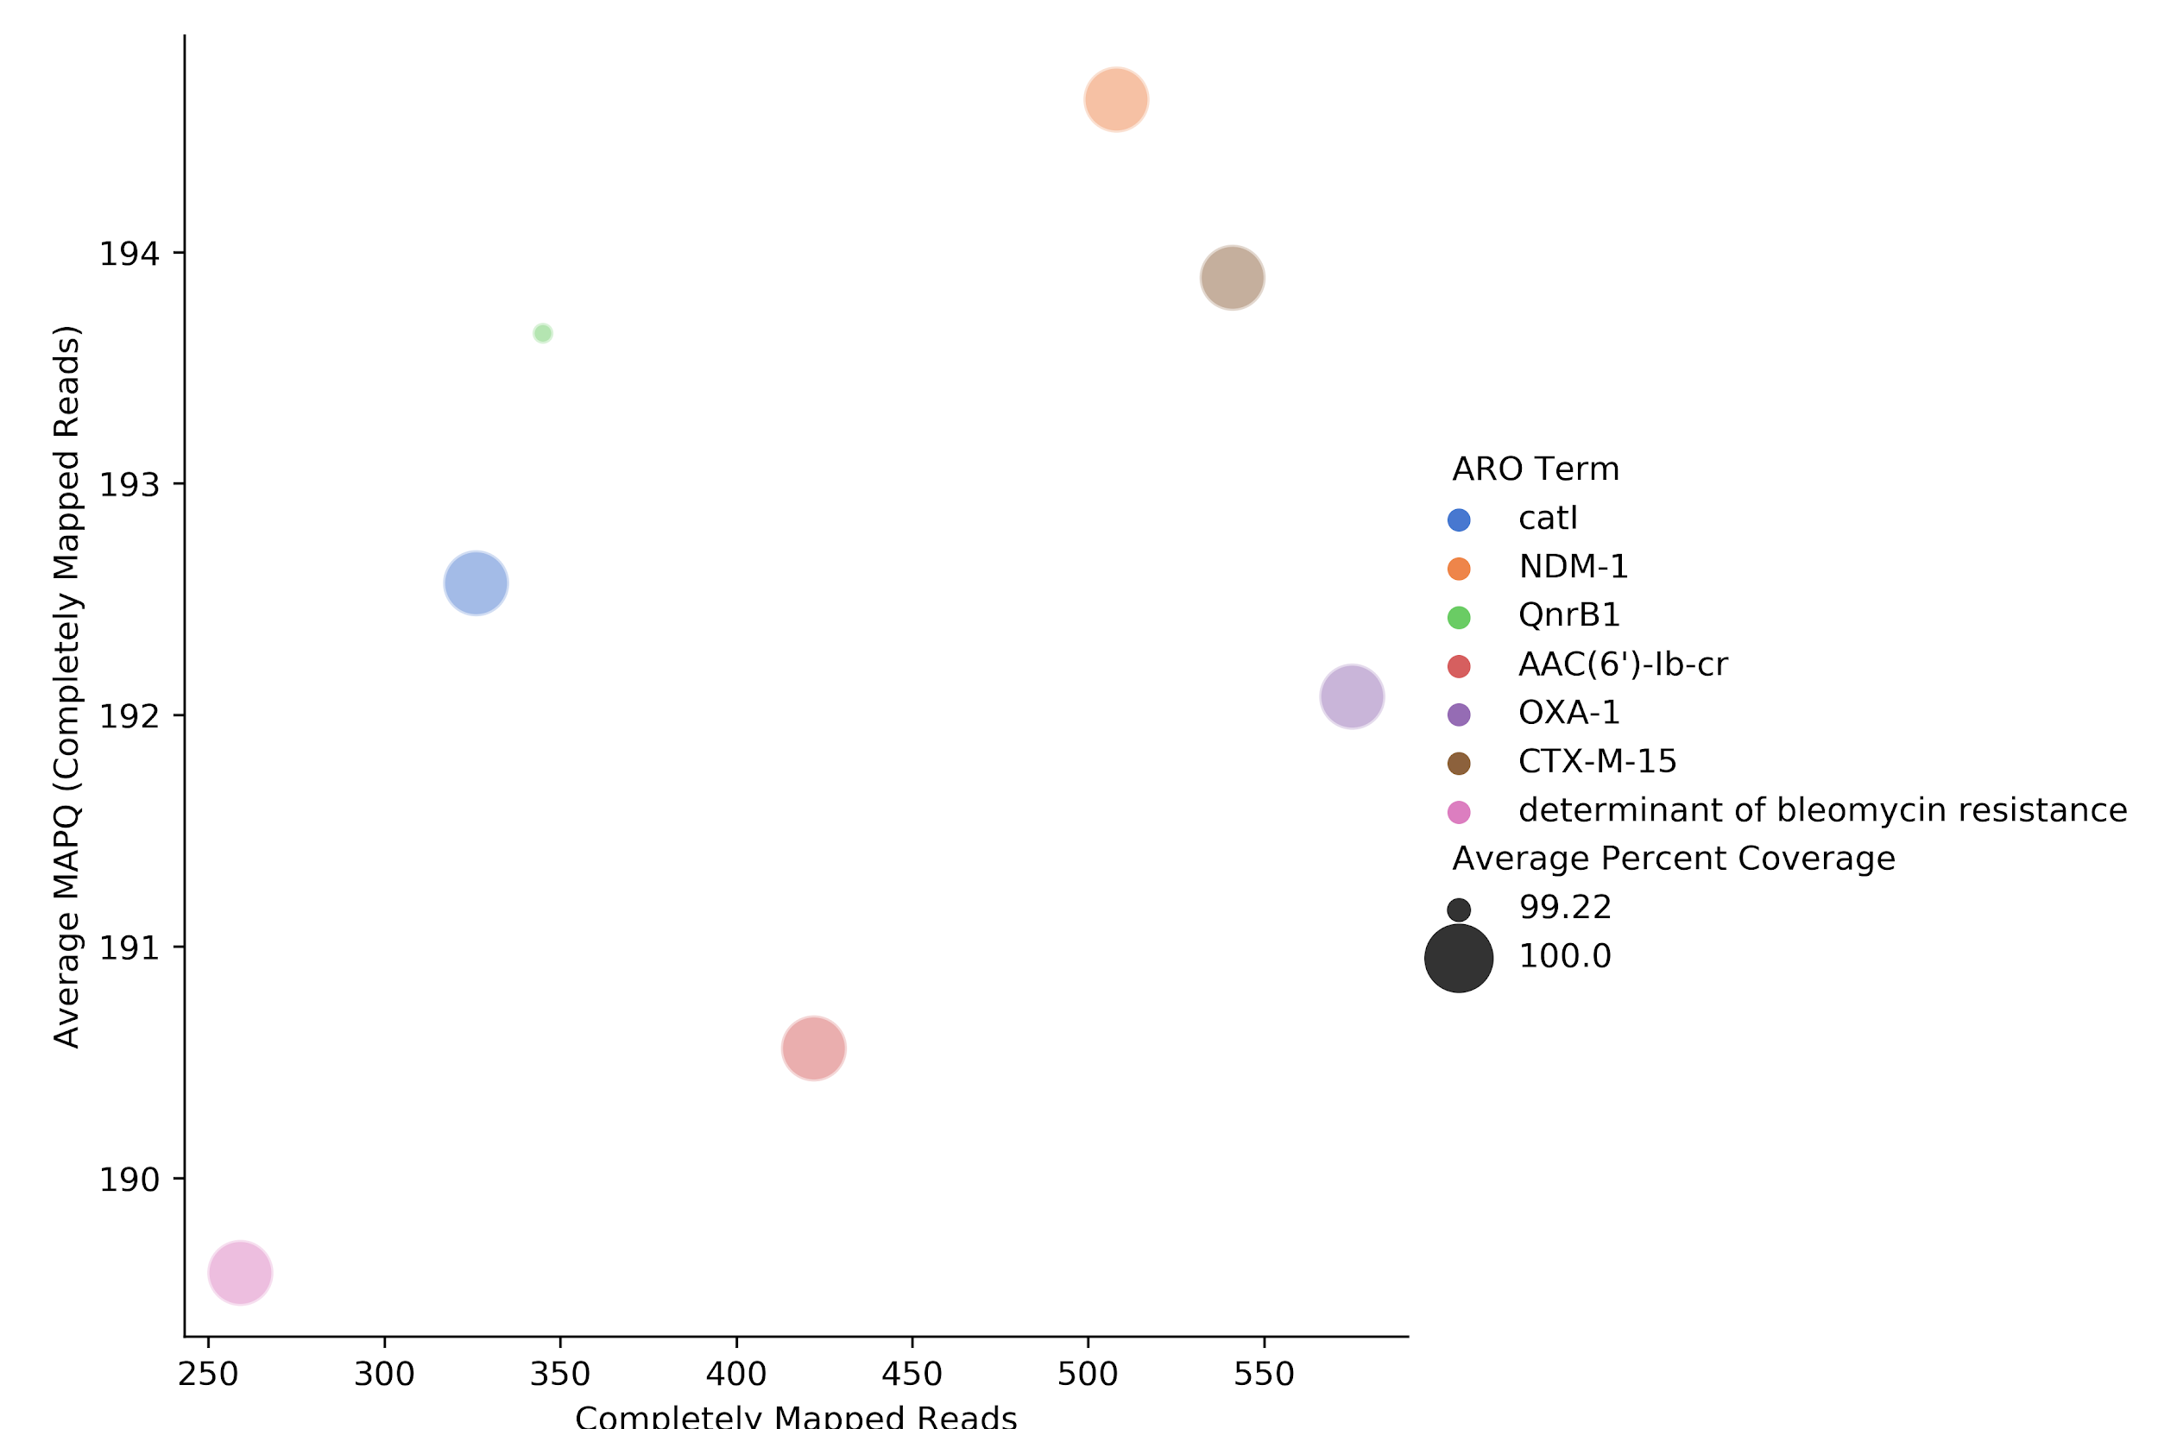
Metagenomics – Culture free sequencing
The AMR Allele Network Problem
Simulated genome (10x coverage) – KMA algorithm
Amos Raphenya, Lead CARD Developer
catB3
AAC(6’)-1b
Clausen et al. 2018. Rapid and precise alignment of raw reads against redundant databases with KMA. BMC Bioinformatics 19:307.

Slide 31
AMR is a ‘One Health’ & ‘Wicked’ Problem
Ethanol
Fuel
AQUACULTURE
ETHANOL FUEL PRODUCERS
Sea / Lakes
Swimming
Drinking
Water
Distillers Grain
By-Products
Drinking
Water
Rivers and Streams
Industrial &
Household
ANTIBACTERIAL
CHEMICALS
Land Fill
Soil
Farm Effluents and Manure Spreading
Sewage
Dead Stock
Wildlife
Rendering
Offal
VEGETATION
SEED CROPS
FRUIT
FOOD
ANIMALS
HUMAN
POULTRY
HOSPITALIZED
COMMUNITY
URBAN AND
RURAL
Animal
Feeds
SHEEP
CATTLE
Commercial
Abattoirs /
Processing
Plants
Handling
Preparation
Consumption
VEAL
CALVES
POULTRY
Meat
EXTENDED
CARE
FACILITIES
TRAVELLERS
OHER
FARMED
LIVESTOCK
COMPANION
ANIMALS
Direct
Contact
Imports

Slide 32


CARD Resistomes
Brian Alcock,
Lead CARD Curator
Mateusz Wlodarski,
PhD Student
Molecular Epidemiology
in silico prediction of AMR genes, resistomes, and sequence variants
413 pathogens, 24291 chromosomes, 2662 genomic islands, 48212 plasmids, 172216 WGS assemblies = 276270 alleles

Slide 33






Slide 34

Predicting Risk

Slide 35


Rules-based algorithm leads to poor phenotype prediction
Number of E. coli isolates (n=115)
Kara Tsang, PhD 2021
Tsang et al. 2021. Identifying novel β-lactamase substrate activity through in silico prediction of antimicrobial resistance. Microbial Genomics 7:mgen000500.

Slide 36

Machine learning algorithm leads to improved phenotype prediction accuracy
Number of E. coli isolates (n=115)
Kara Tsang, PhD 2021
Tsang et al. 2021. Identifying novel β-lactamase substrate activity through in silico prediction of antimicrobial resistance. Microbial Genomics 7:mgen000500.

Slide 37




~204,000 AMR papers in PubMed
~10,000 added AMR papers per year
Arman Edalatmand
MSc 2022
~10k papers from 2019
Lee et al. 2019. BioBERT: a pre-trained biomedical language representation model for biomedical text mining. arXiv:1901.08746.

Slide 38



Big Data - Creating an Internet of DNA
Rapid Response Strategies
Early Detection of Emergent Threats
Inform Public Policy
Guide Clinical Practice
Enable Targeted Drug Development
artificial intelligence
machine learning
Aspergillomarasmine A vs. NDM-1
King et al. Nature 2014 510:503-506
adjuvants!
lipid targets!
Teixobactin vs. lipids
Ling et al. Nature 2015 517:455-459

Slide 39


SARS-CoV-2

Slide 40

Genomics Revolution in Infectious Disease
December 31, 2019: Wuhan Municipal Health Commission, China, reported a cluster of cases of pneumonia in Wuhan, Hubei Province
January 12, 2020: Nearly complete SARS-CoV-2 genome sequence obtained and shared by Chinese Center for Disease Control and Prevention

Slide 41
Genomics Revolution in Infectious Disease
Nasal swab RT-PCR diagnostics
First successful development & deployment of pathogen mRNA vaccines
Global transmission patterns by variant tracking
Variants of Concern

Slide 42


Summer 2019 – Viral Bait Capture
3 million available virus genome sequences
Existing design methods would result in over 85,000,000 hybridization baits
Jalees Nasir, PhD 2025
Syndromic bait sets
Focus on respiratory viruses first
30% are lacking diagnostic tools
Include seasonal and other coronaviruses
Robert Kozak, Samira Mubareka (Sunnybrook Health Sciences)

Slide 43

Robert Kozak, Samira Mubareka (Sunnybrook Health Sciences)
Arinjay Banerjee (McMaster / VIDO)
Banerjee et al. 2020. Isolation, sequence, infectivity and replication kinetics of SARS-CoV-2. Emerging Infectious Diseases, 26, 2054-2063.

Slide 44


Banerjee et al. 2020. Isolation, sequence, infectivity and replication kinetics of SARS-CoV-2. Emerging Infectious Diseases, 26, 2054-2063.

Slide 45

What is the risk for mutations?
~28,000 bp genome
Intrinsic mutation rate is low due to nonstructural protein 14 (nsp14): 3′-to-5′ exoribonuclease (ExoN) and guanine-N7-methyltransferase (N7-MTase) activities
Risk of diagnostic mutations?
Risk of mutations that change biological properties? – selective pressures?
Genome analysis must be intolerant of sequencing error!

Slide 46




April 2020

Slide 47



How do we sequence SARS-CoV-2?
E. coli
Culture to obtain large amount of clean DNA of pathogen
Random fragmentation of DNA – each part of the genome is equally sampled
Graph based computational assembly of the consensus genome
Highly redundant sequencing of each nucleotide; at least 100x
Sequencing error is nearly random; overcome by redundancy

Slide 48

How do we sequence SARS-CoV-2?
BSL3
Arinjay Banerjee and friends

Slide 49

How do we sequence SARS-CoV-2?
cDNA
reverse transcriptase
Overlapping PCR Amplicons -> Illumina Sequencing
Liverpool – 30 amplicons
ARTIC3 – 98 amplicons

Slide 50
How do we sequence SARS-CoV-2?
cDNA
reverse transcriptase
Overlapping PCR Amplicons -> Illumina Sequencing
Culture to obtain large amount of clean DNA of pathogen
Random fragmentation of DNA – each part of the genome is equally sampled
Graph based computational assembly of the consensus genome
Highly redundant sequencing of each nucleotide; at least 100x
Sequencing error is nearly random; overcome by redundancy
Patient DNA!
Read alignment & variant strategy
10x coverage
Liverpool – 30 amplicons
ARTIC3 – 98 amplicons

Slide 51



SIGNAL: SARS-CoV-2 Illumina GeNome Assembly Line
https://github.com/jaleezyy/covid-19-signal
J.A. Nasir
R.A. Kozak
P. Aftanas
A.R. Raphenya
K.M. Smith
F. Maguire
H. Maan
M. Alruwaili
A. Banerjee
H. Mbareche
B.P. Alcock
N.C. Knox
K. Mossman
B. Wang
J.A. Hiscox
A.G. McArthur
S. Mubareka
Jalees Nasir
Amos Raphenya
Kendrick Smith (Perimeter Institute)
Finlay Maguire (Dalhousie)
Natalie Knox (PHAC)
Nasir et al. SARS-CoV-2 Illumina GeNome Assembly Line (SIGNAL). NAR Genomics and Bioinformatics, in press.

Slide 52


SIGNAL: SARS-CoV-2 Illumina GeNome Assembly Line
https://github.com/jaleezyy/covid-19-signal
J.A. Nasir
R.A. Kozak
P. Aftanas
A.R. Raphenya
K.M. Smith
F. Maguire
H. Maan
M. Alruwaili
A. Banerjee
H. Mbareche
B.P. Alcock
N.C. Knox
K. Mossman
B. Wang
J.A. Hiscox
A.G. McArthur
S. Mubareka
Jalees Nasir
Nasir et al. SARS-CoV-2 Illumina GeNome Assembly Line (SIGNAL). NAR Genomics and Bioinformatics, in press.

Slide 53


Deployment!
Snakemate bioinformatics!

Slide 54

November 24, 2020 ‘Point Prevalence’
World Total: 1,693,731 virus genomes
Canada Total: 41,730 virus genomes (of 150,000 target)
USA Total: 421,001 virus genomes
UK Total: 221,370 virus genomes

Slide 55

November 24, 2020 ‘Point Prevalence’

Slide 56
November 24, 2020 ‘Point Prevalence’
early warning!
cousin of ‘Gamma’ VOC

Slide 57

November 24, 2020 ‘Point Prevalence’

Slide 58

GISAID.org

Slide 59

Science during a Crisis
Emily Panousis, BDC ‘22
During the first & second wave McMaster produced 50% of Ontario’s and 20% of Canada’s internationally shared SARS-CoV-2 genome sequence data
No winter holidays for 2 years – VOCs emerged in Nov/Dec
Rapid turn-around & working outside of our training
Designation of Hamilton as a Delta Variant hotspot & redeployment of vaccines
Rapid resolution of the R.1 outbreak in Hamilton’s homeless communities

Slide 60


International Efforts

Slide 61

International Efforts
What gets named?
phylogenetic lineage
differential mutations
epidemiological association
24/7 Real Time Epidemiology!

Slide 62





Working at the tail end of a pandemic…
Dr. Sheridan Baker
Dr. Jalees Nasir

Slide 63

Genomics Revolution in Infectious Disease

Slide 64

Thanks!
Dr. Gerry Wright, IIDR, and the CARD Consortium
GenEpiO Consortium
National Microbiology Laboratory, Canada – IRIDA Surveillance Project
National Center for Biotechnology Information (NCBI, USA)
bioMérieux France, Inc.
IslandViewer Database – Dr. Fiona Brinkman, UBC
McMaster Industrial Liaison Office!

Slide 65



Sequencing & Bioinformatics Team!
Patryk Aftanas
(Sunnybrook)
Jalees Nasir
Mike Surette
Hooman Derakhshani
Laura Rossi
Emily Panousis
Sheridan Baker

Slide 66








Thanks!
McArthur Lab
Jalees Nasir, Amos Raphenya, Emily Panousis, Ahmed Draia & my very patient lab
McMaster
Mike Surette, Hooman Derakhshani, Sheridan Baker, Arinjay Banerjee, Farncombe Sequencing Team, MILO, CSU, HiREB, Gina Mannen, Gerry Wright, Karen Mossman
ONCoV, ONS2, Sunnybrook
Jared Simpson, Samira Mubareka, Rob Kozak, Robyn Lee, Ramzi Fattouh, Hamza Mbareche, Kyuganya Nirmalarajah, Patryk Aftanas , and so many more…
CanCOGeN
Gary Van Domselaar, Natalie Knox, and the many working groups (QC & BC especially!)
The ‘Hackers’
Finlay Maguire, Kendrick Smith, Hassaan Maan, Bo Wang, DNAStack

Slide 67




End of Course!

